Slide 1
Amani Mvomero
Names of Clients.
2016/2017

Slide 2
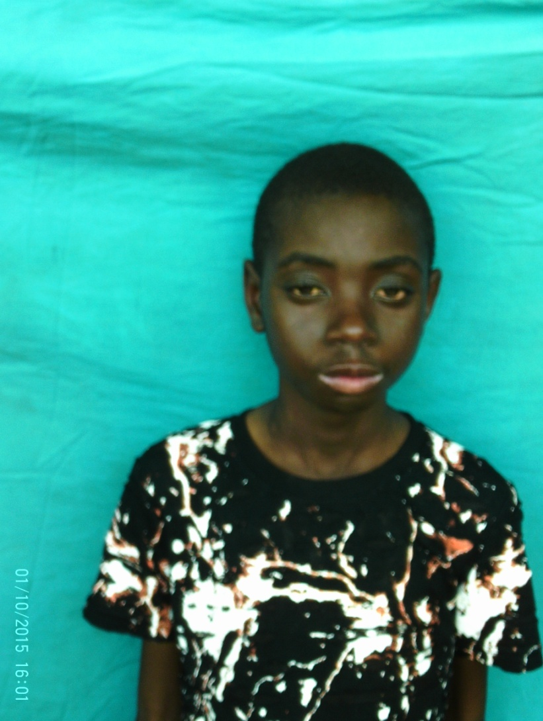
Name:Abdala Alfan
Date of birth:
Ward: Mvomero
District: Mvomero
Region: morogoro
Type of disability: Mental Disability

Slide 3
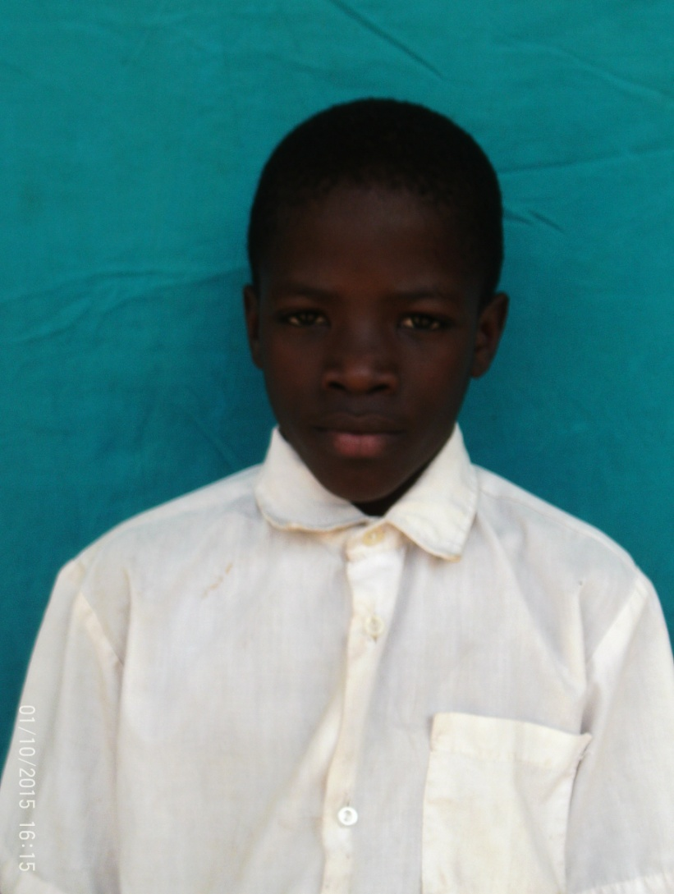
Name:Shabani Masudi
Date of birth:
Ward: Mvomero
District: Mvomero
Region: morogoro
Type of disability: Normal

Slide 4
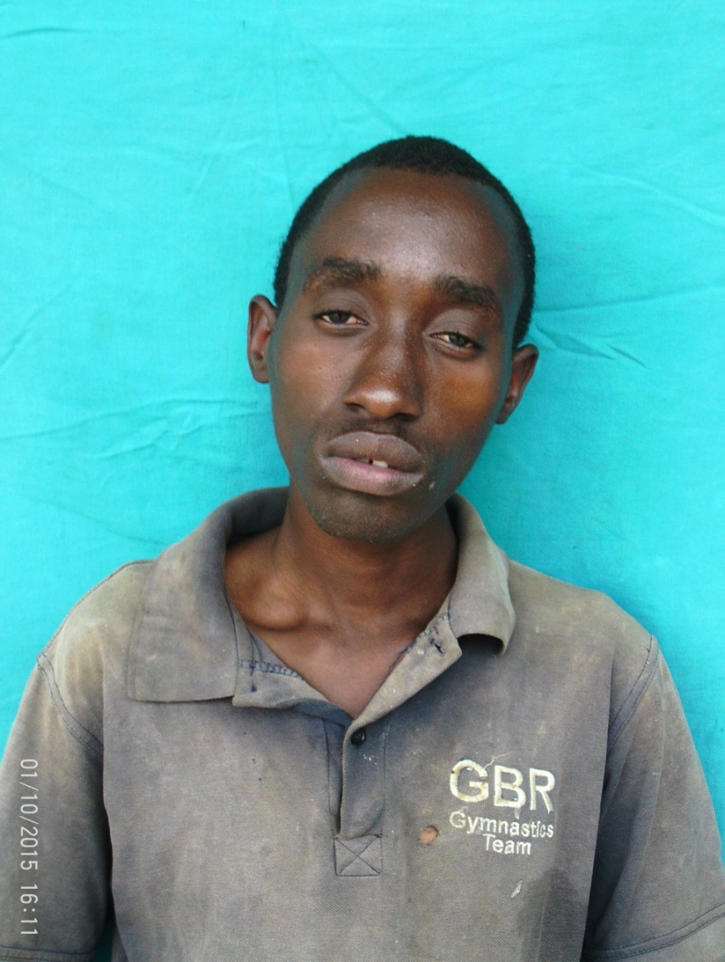
Name:Mashaka
Date of birth:
Ward: Mvomero
District: Mvomero
Region: morogoro
Type of disability: Mental Disability

Slide 5
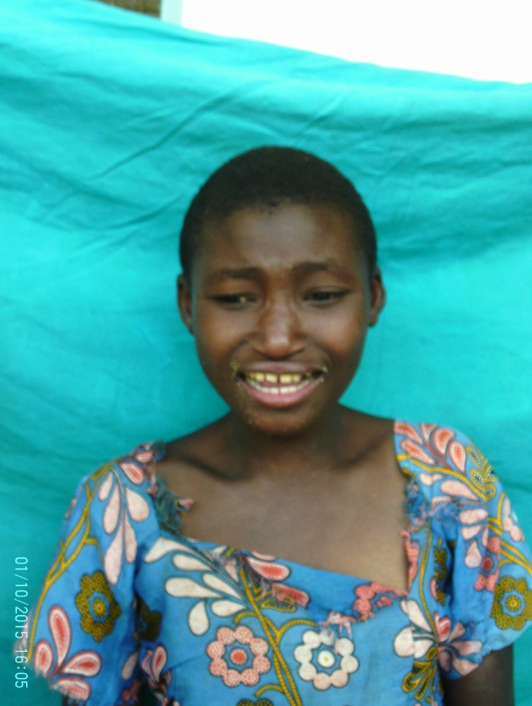
Name:Ave maria amani
Date of birth:
Ward: Mvomero
District: Mvomero
Region: morogoro
Type of disability: Mental Disability

Slide 6
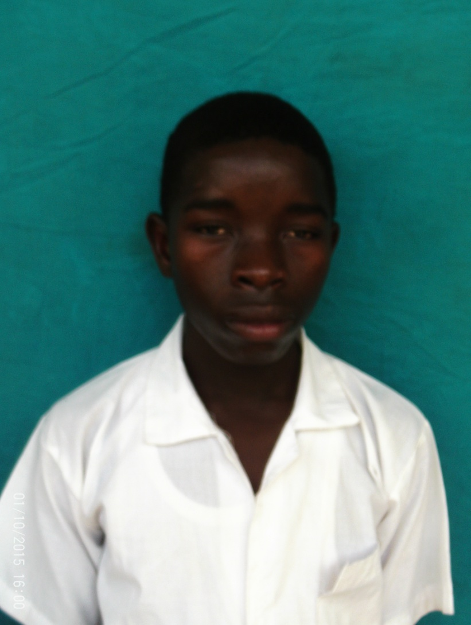
Name:Primas
Date of birth:
Ward: Chamwino
District: Morogoro municipal
Region: morogoro
Type of disability: Deaf and Dumb

Slide 7
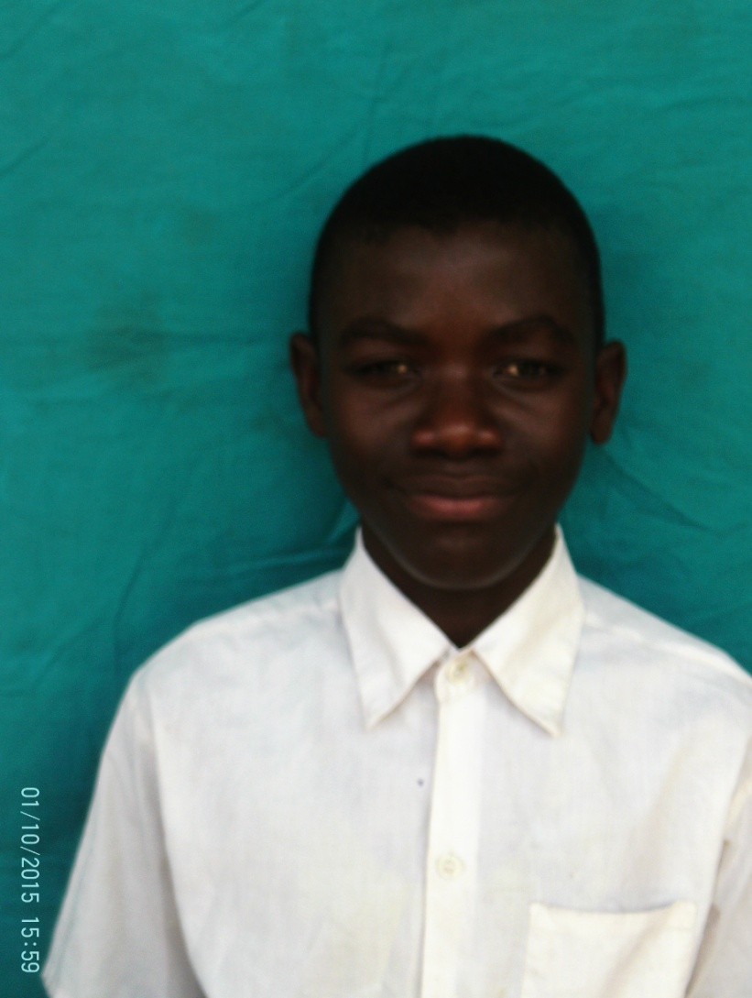
Name:wahabi Hassani
Date of birth:
Ward: Mvomero
District: Mvomero
Region: morogoro
Type of disability: Deaf and Dumb

Slide 8
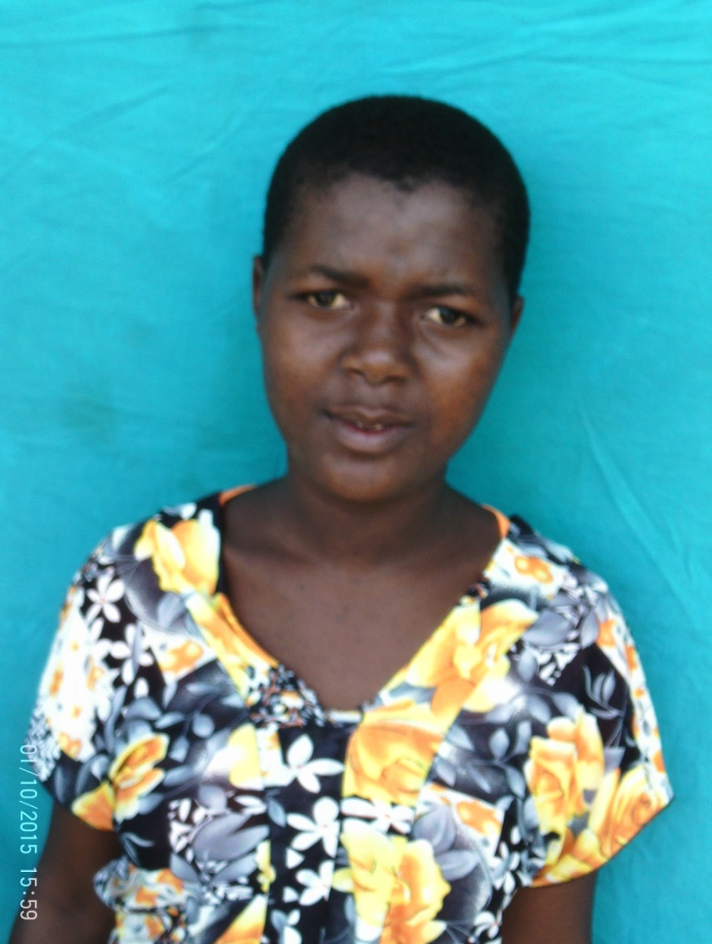
Name:Fatuma Saidi
Date of birth:
Ward: Mvomero
District: Mvomero
Region: morogoro
Type of disability: Mental Disability

Slide 9
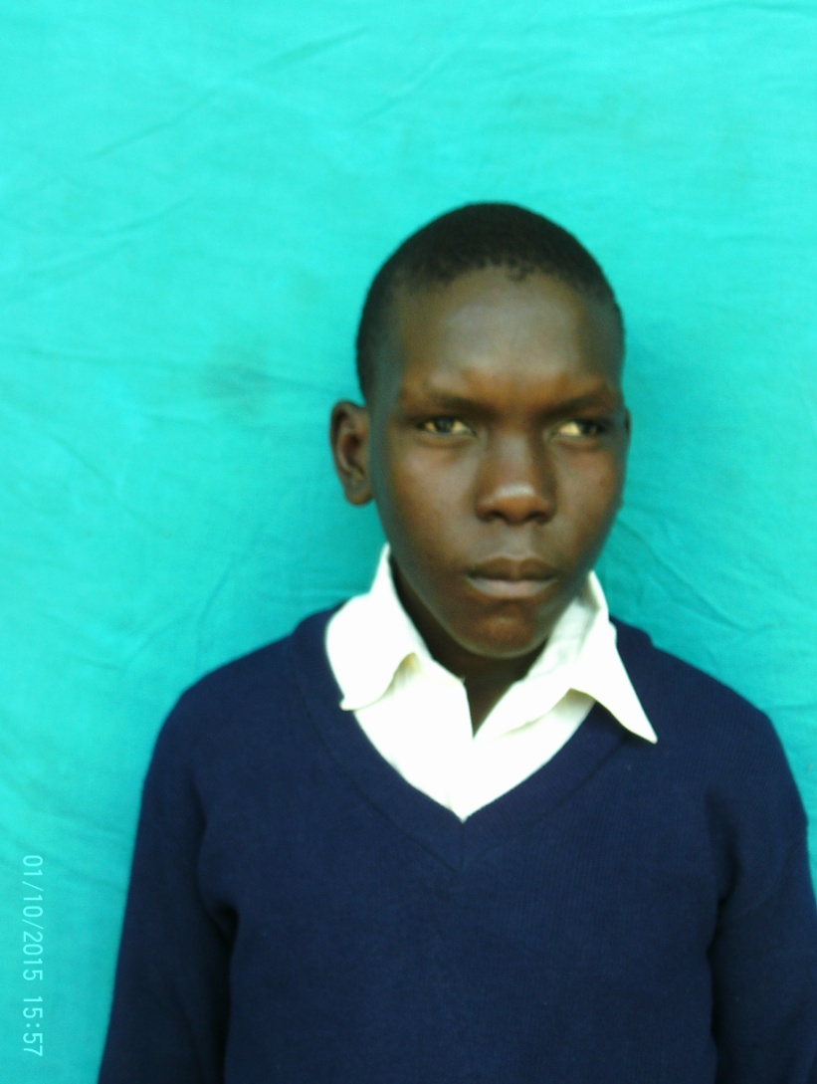
Name: emmanuel S. Mwenura
Date of birth:
Ward: Mvomero
District: Mvomero
Region: morogoro
Type of disability: Mental Disability

Slide 10
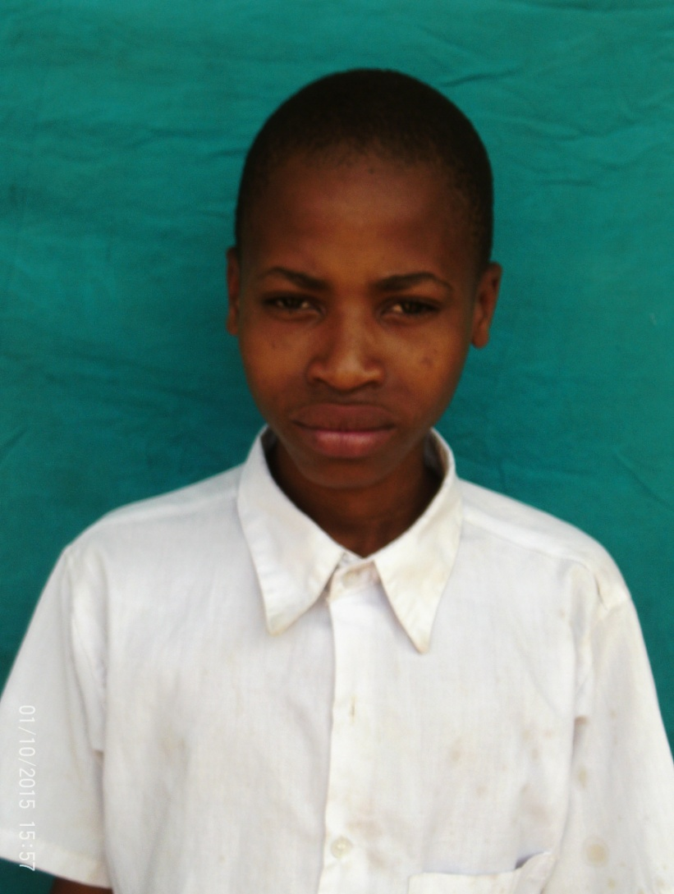
Name:Shabani Magomba
Date of birth:
Ward: Mvomero
District: Mvomero
Region: morogoro
Type of disability: Deaf and Dumb

Slide 11
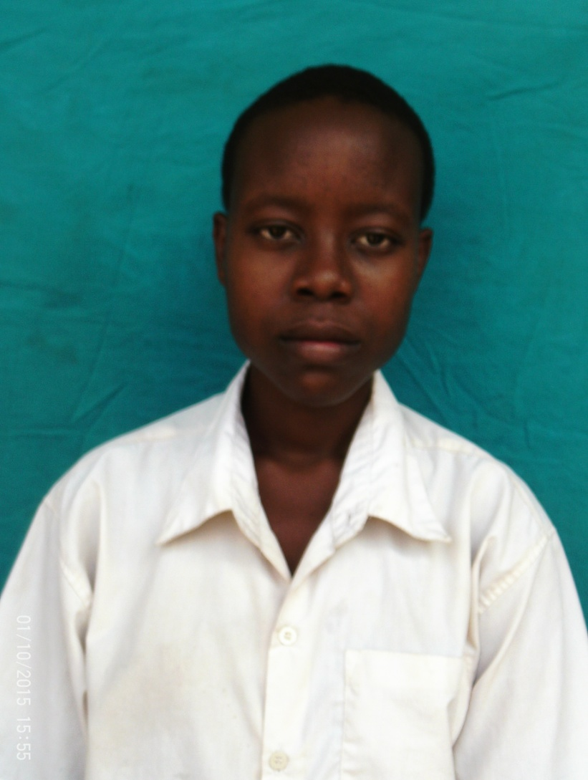
Name: Asimwe Kalokola
Date of birth:
Ward: Mvomero
District: Mvomero
Region: morogoro
Type of disability: Slow learner

Slide 12
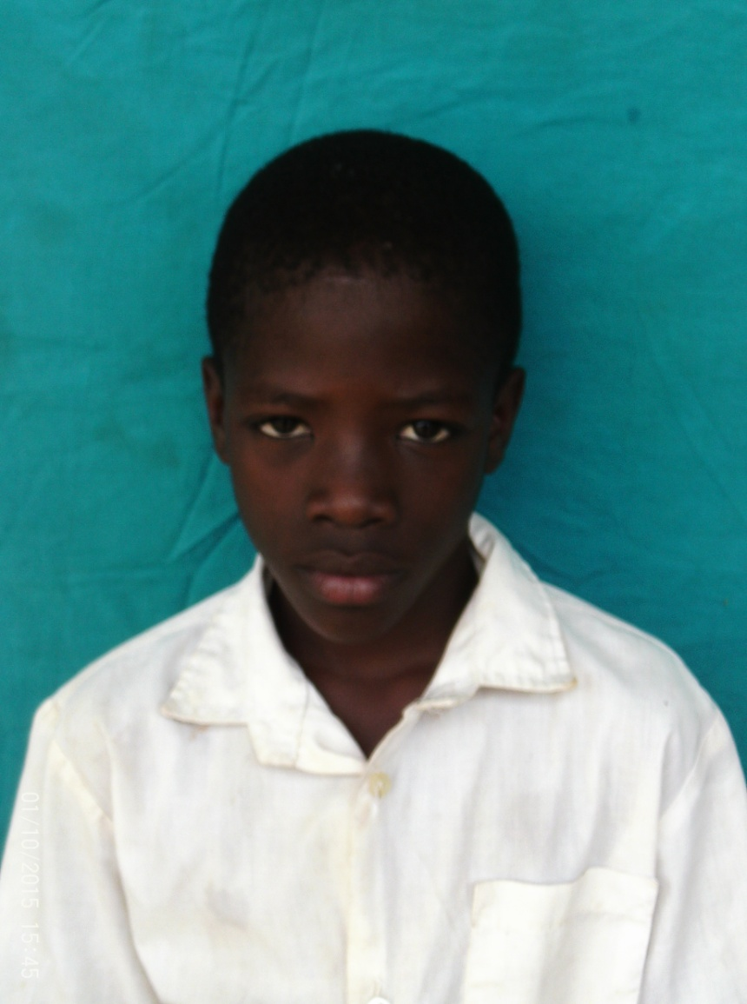
Name:Shabani Masudi
Date of birth:
Ward: Mvomero
District: Mvomero
Region: morogoro
Type of disability: Deaf and Dumb

Slide 13
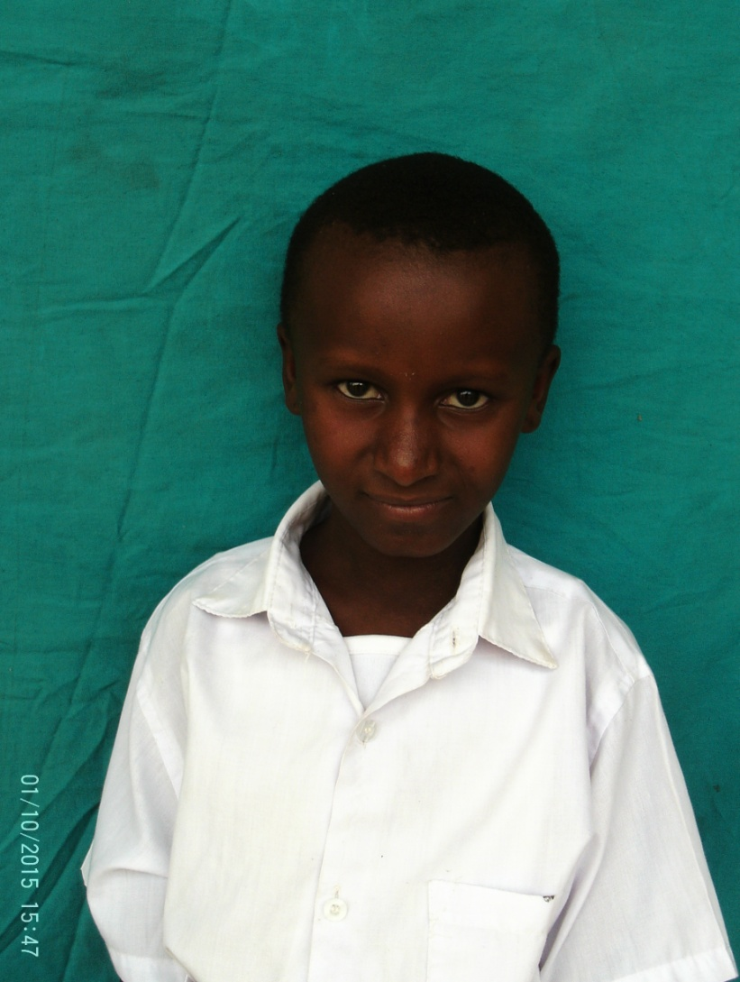
Name: Eunis Nolasco
Date of birth:
Ward: Mvomero
District: Mvomero
Region: morogoro
Type of disability: Deaf and Dumb

Slide 14
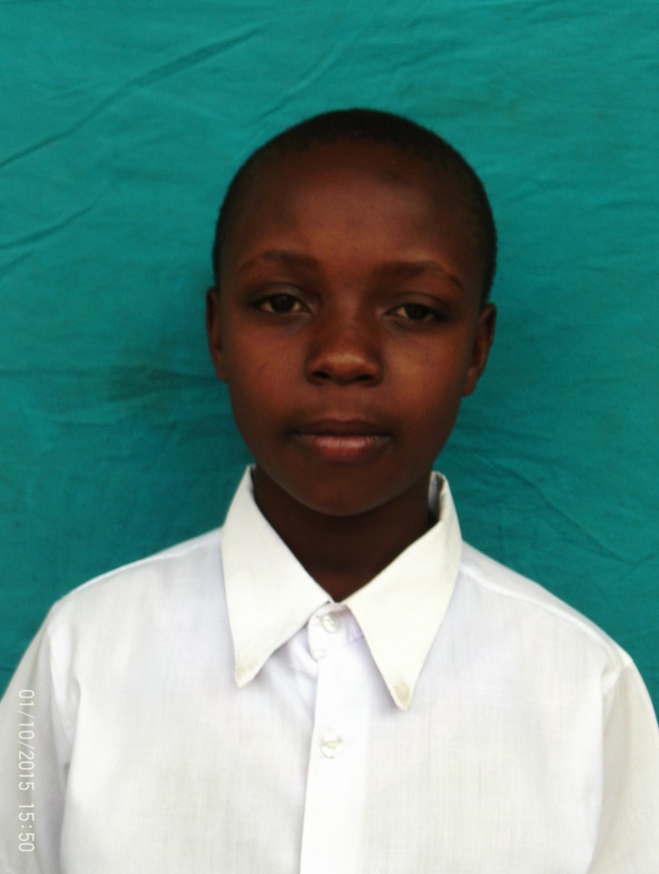
Name: Sabrina juma
Date of birth:
Ward: Mvomero
District: Mvomero
Region: morogoro
Type of disability: Nomal

Slide 15
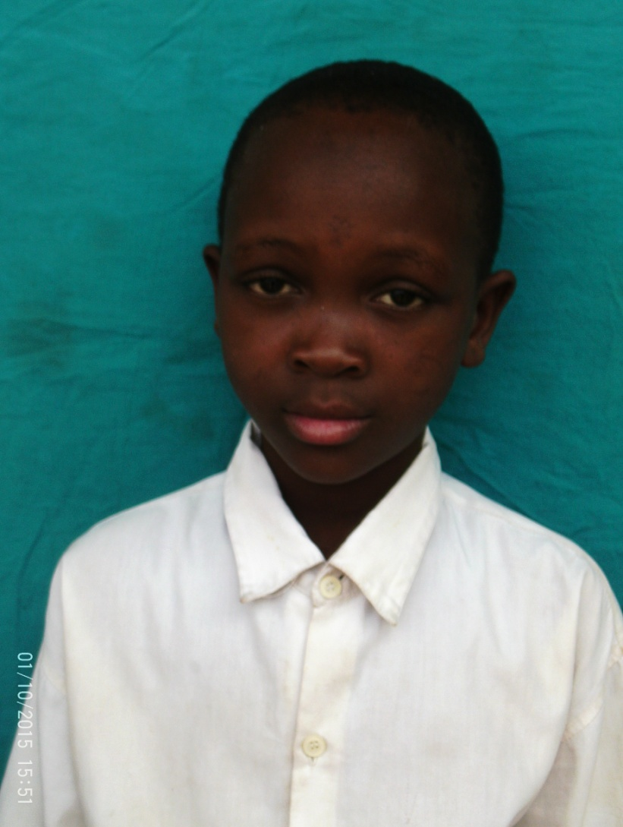
Name: Zainabu John
Date of birth:
Ward: Mvomero
District: Mvomero
Region: morogoro
Type of disability: Deaf and Dumb

Slide 16
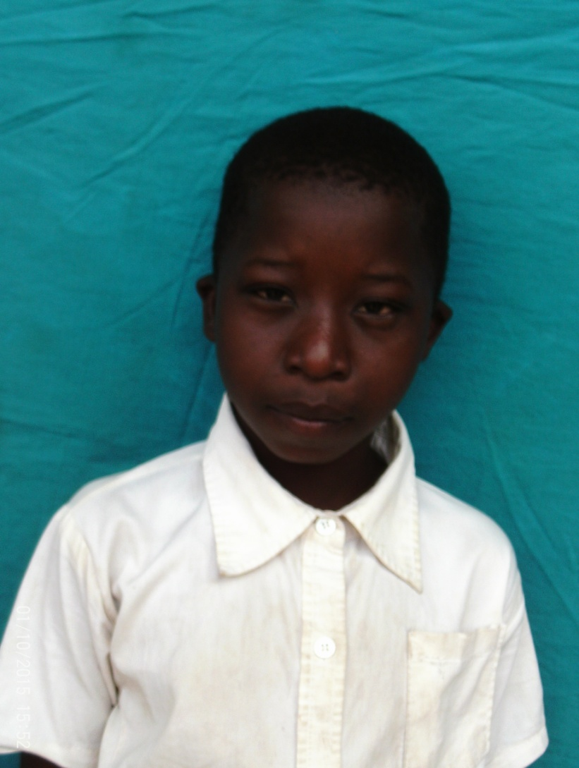
Name:Hadija Kilo
Date of birth:
Ward: Mvomero
District: Mvomero
Region: morogoro
Type of disability: Deaf and Dumb

Slide 17
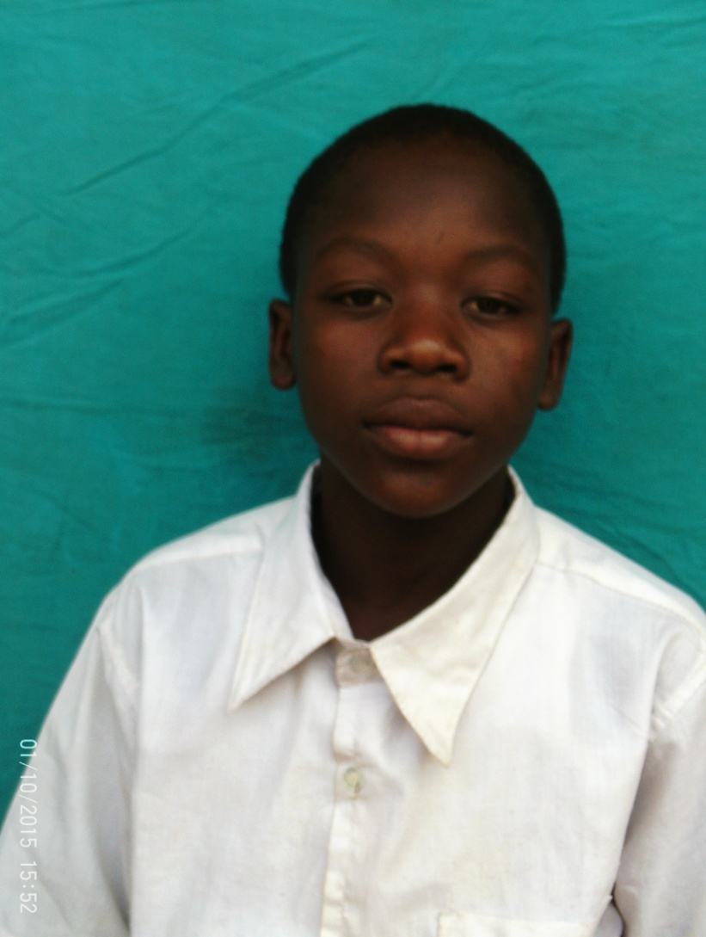
Name:Kelvin Hamisi
Date of birth:
Ward: Mvomero
District: Mvomero
Region: morogoro
Type of disability: Deaf and Dumb

Slide 18
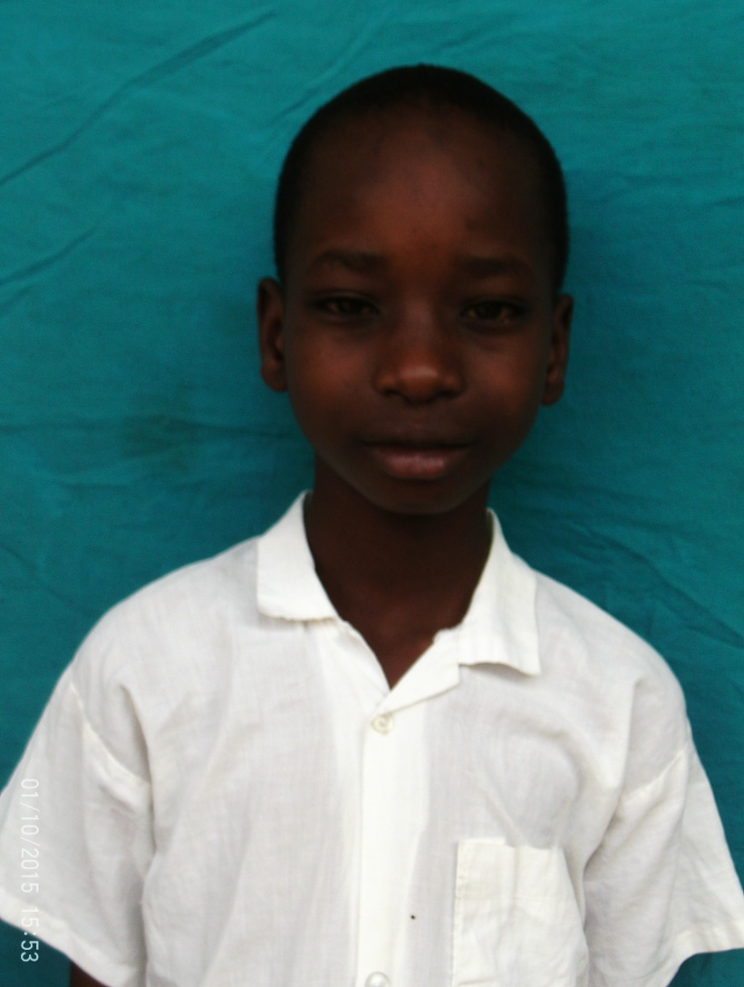
Name: Bruno Emmanuel
Date of birth:
Ward: Mvomero
District: Mvomero
Region: morogoro
Type of disability: Deaf and Dumb

Slide 19
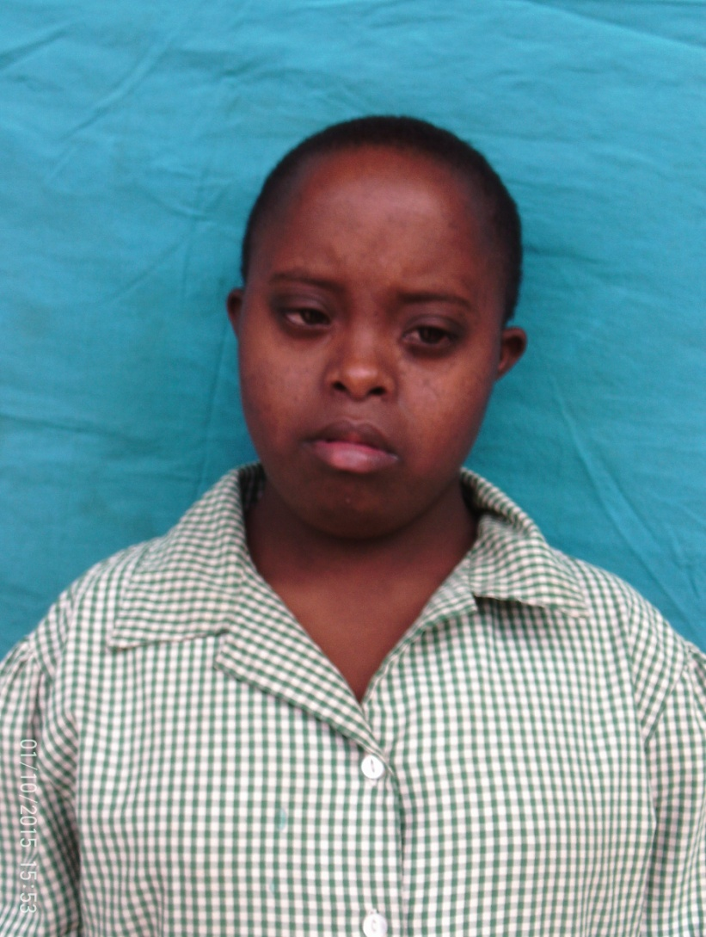
Name: Victoria Mrosso
Date of birth:
Ward: Mvomero
District: Mvomero
Region: morogoro
Type of disability: Down syndrome

Slide 20
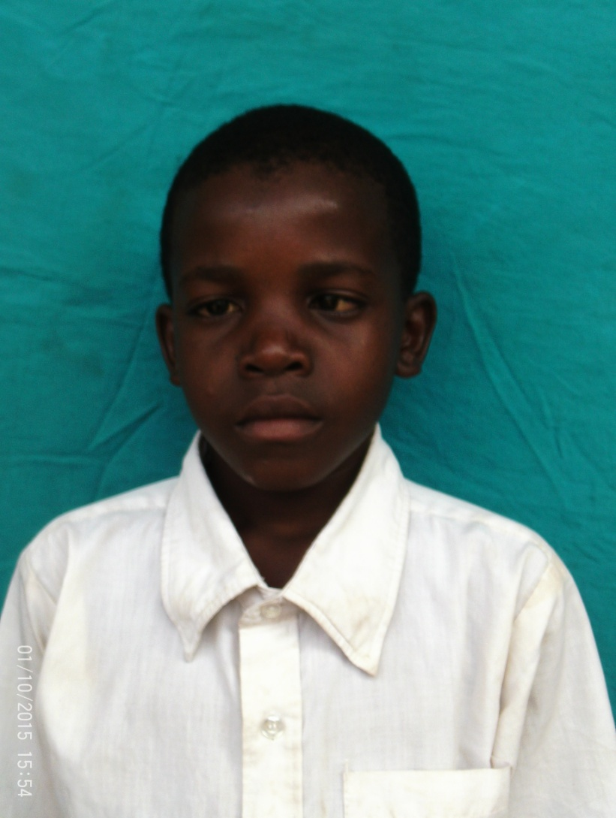
Name:Hamza Mruma
Date of birth:2006
Ward: Mvomero
District: Mvomero
Region: morogoro
Type of disability: Deaf and Dumb

Slide 21
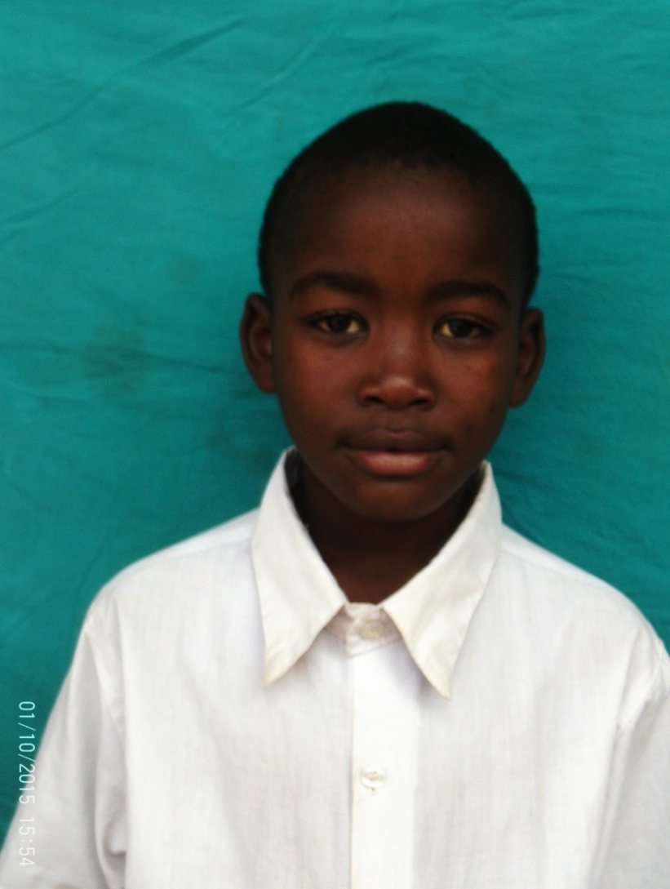
Name: Johnson Komba
Date of birth:2010
Ward: Mvomero
District: Mvomero
Region: morogoro
Type of disability: Deaf and Dumb

Slide 22
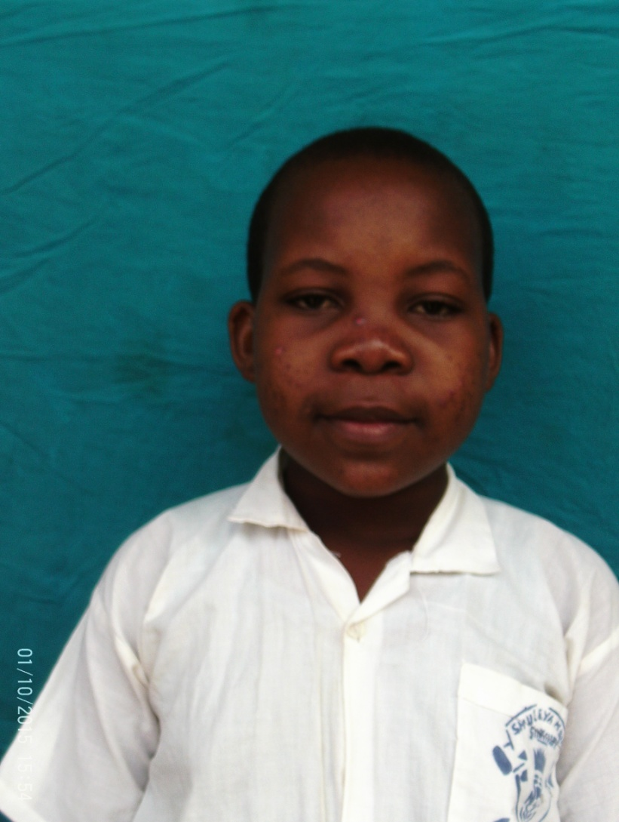
Name:Lucia Francis
Date of birth:
Ward: Mvomero
District: Mvomero
Region: morogoro
Type of disability:Normal

Slide 23
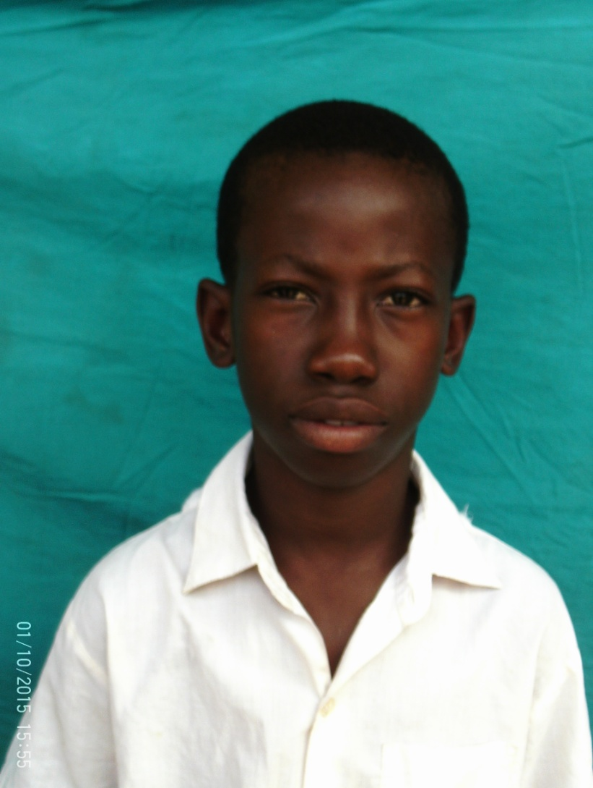
Name:Yohana Masatus
Date of birth:
Ward: Mvomero
District: Mvomero
Region: morogoro
Type of disability:Deaf and Dumb

Slide 24
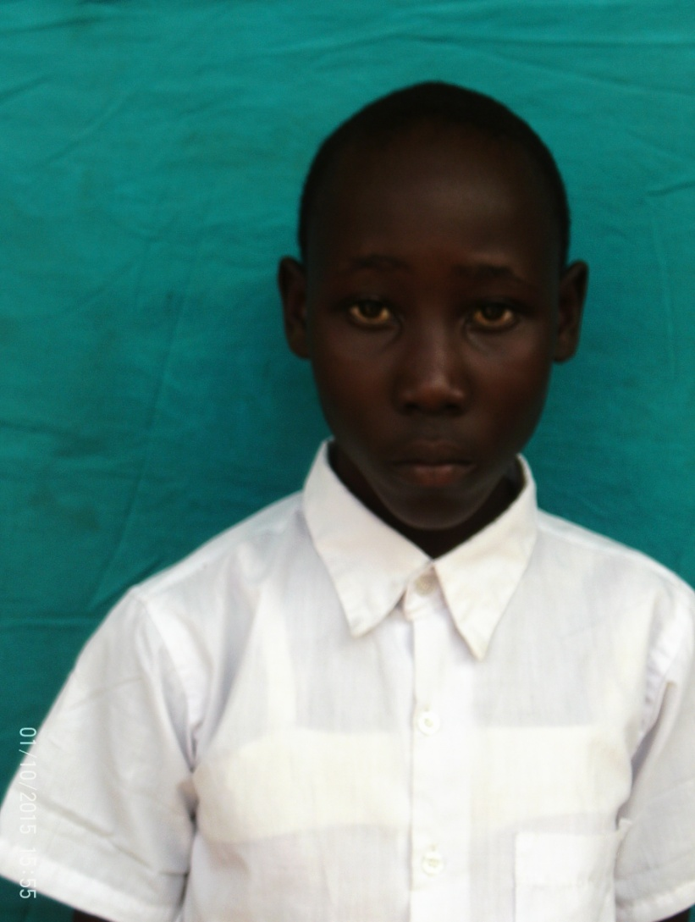
Name:Benadetha Gowele
Date of birth:2002
Ward: Mvomero
District: Mvomero
Region: morogoro
Type of disability: Deaf and Dumb

Slide 25
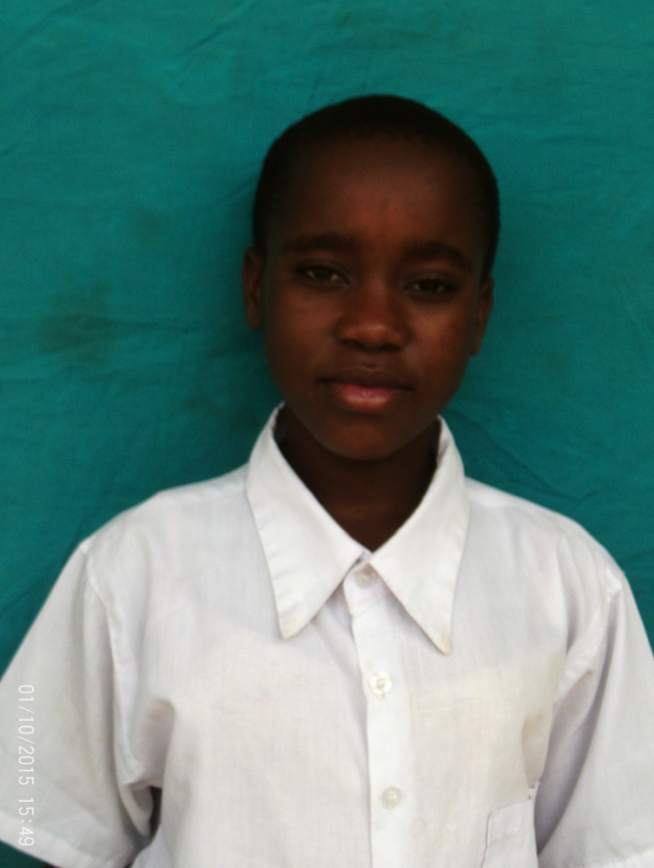
Name:Radhia Twahil
Date of birth:
Ward: Chamwino
District: Mvomero
Region: morogoro
Type of disability:Deaf and Dumb

Slide 26
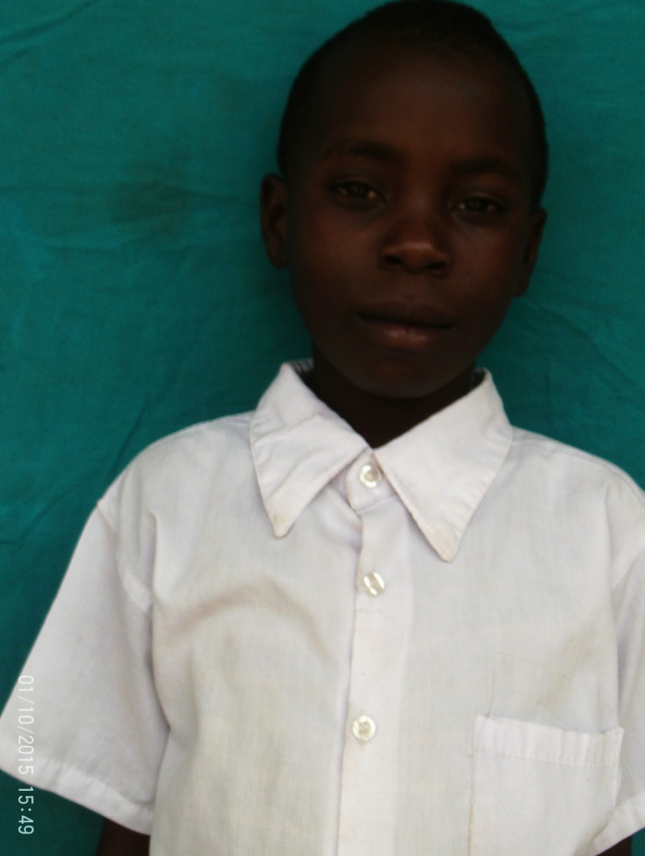
Name:Johari Ally
Date of birth:
Ward: Mvomero
District: Mvomero
Region: morogoro
Type of disability: Deaf and Dumb

