Slide 1
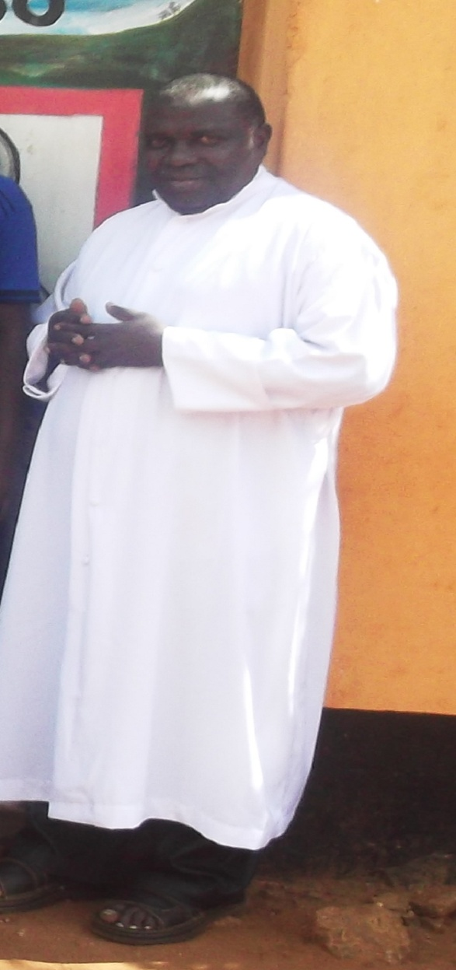
FR. BEATUS M.SEWANDO
DIRECTOR OF AMANI

Slide 2
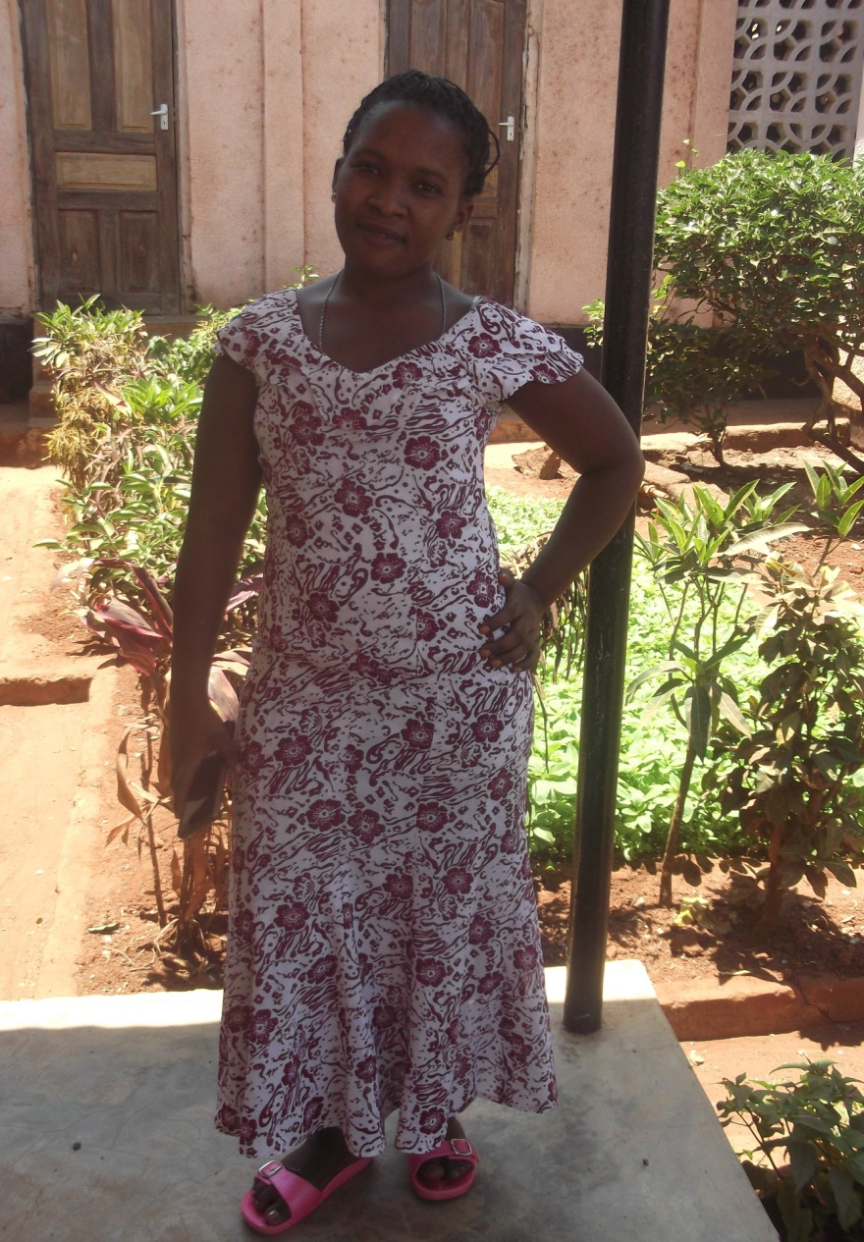
CONSTANCIA MAGOMBA
AMANI SECRETARY

Slide 3
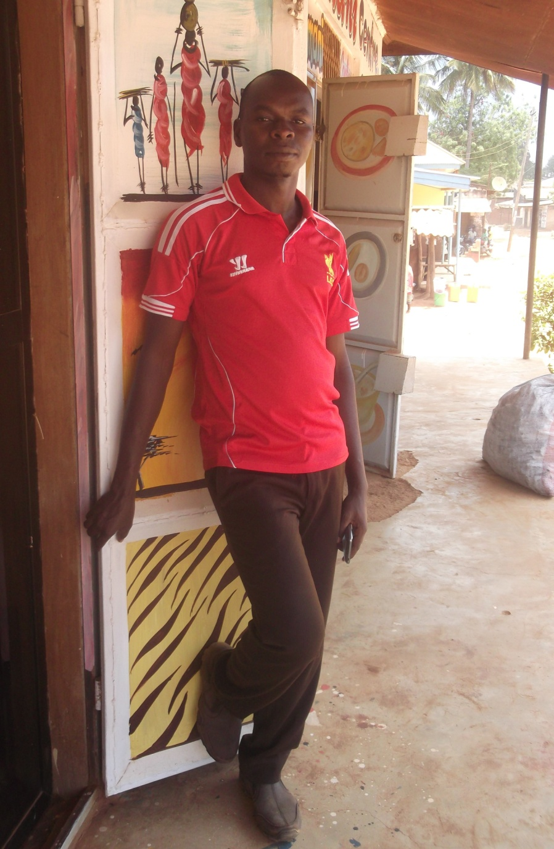
SALVATORY AGUSTINO
AMANI SOCIAL WOKER

Slide 4
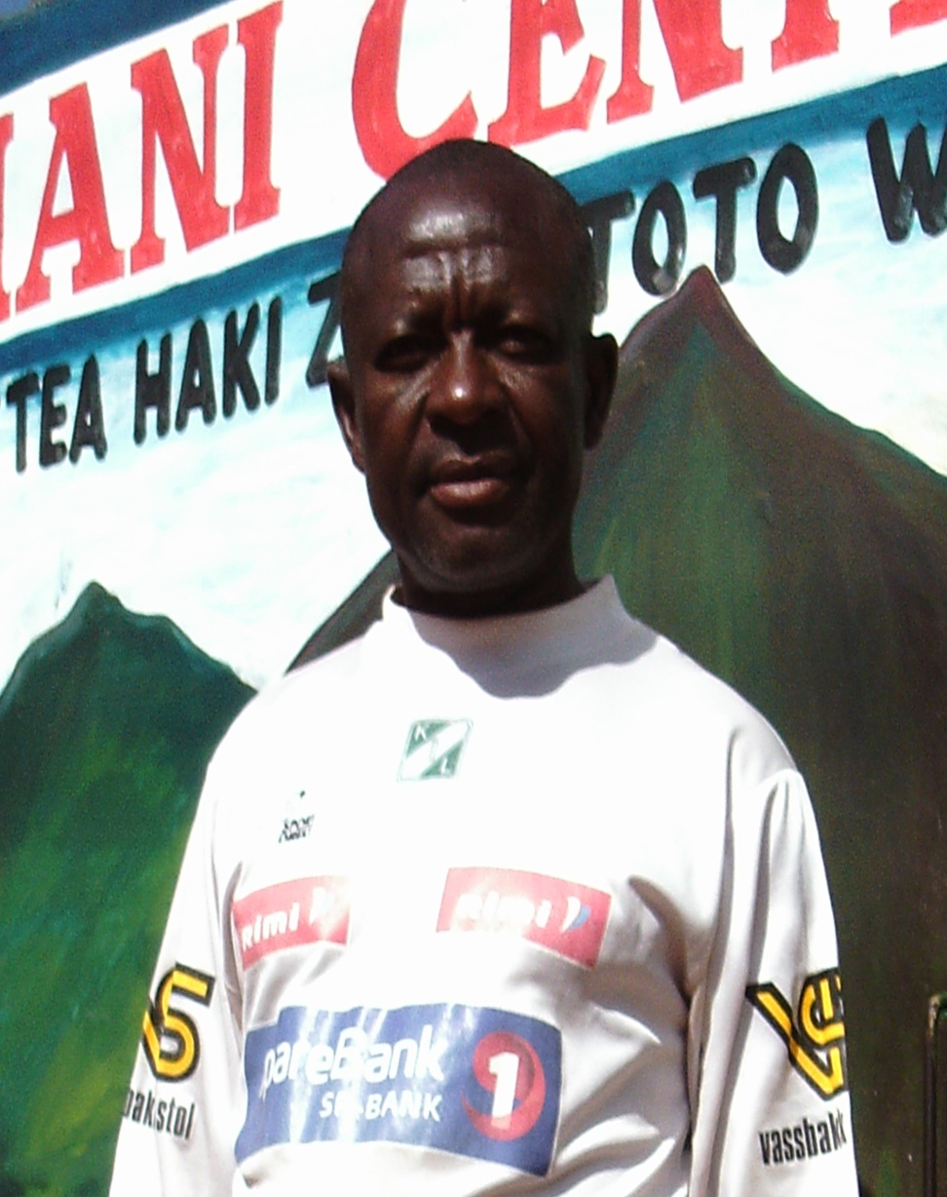
SIJARI OMARY
AMANI COMMUNITY WOKER

Slide 5
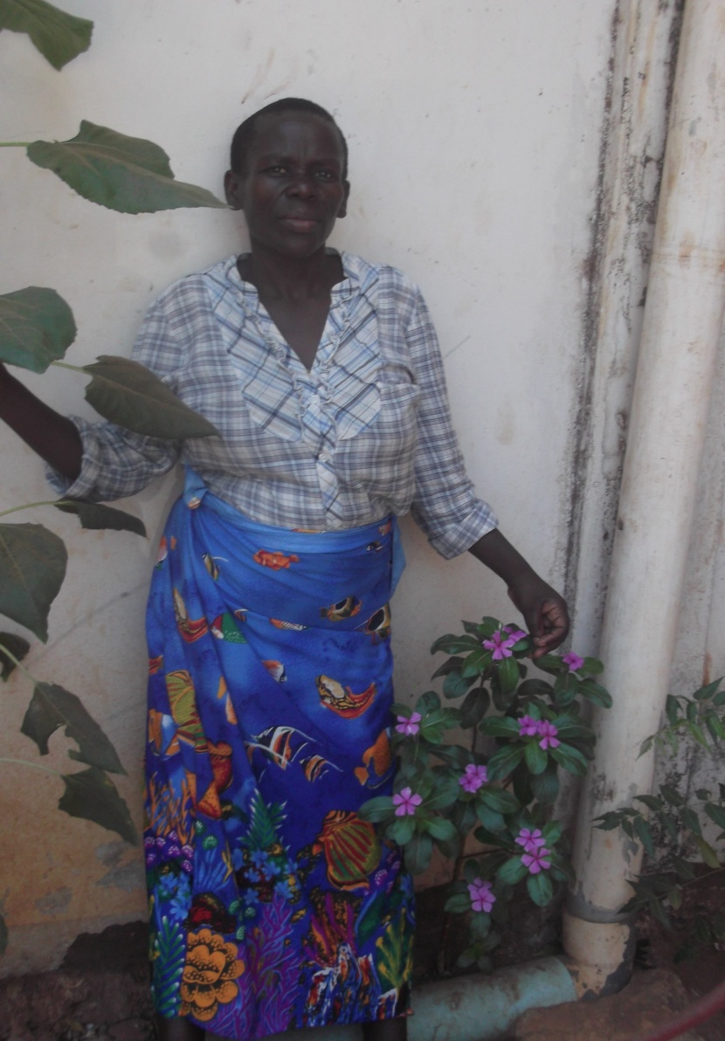
CONSTANSIA MSELEWA
HEAD OF AMANI DAY CARE

Slide 6
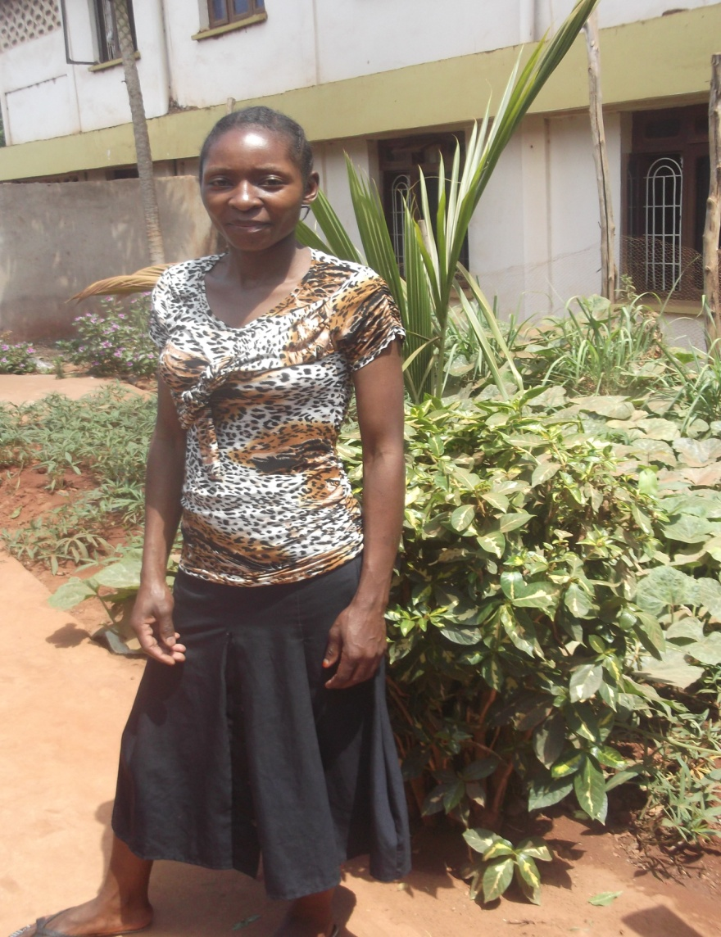
JOYCE NGAIRO
HEAD OF AMANI CANTEEN

Slide 7
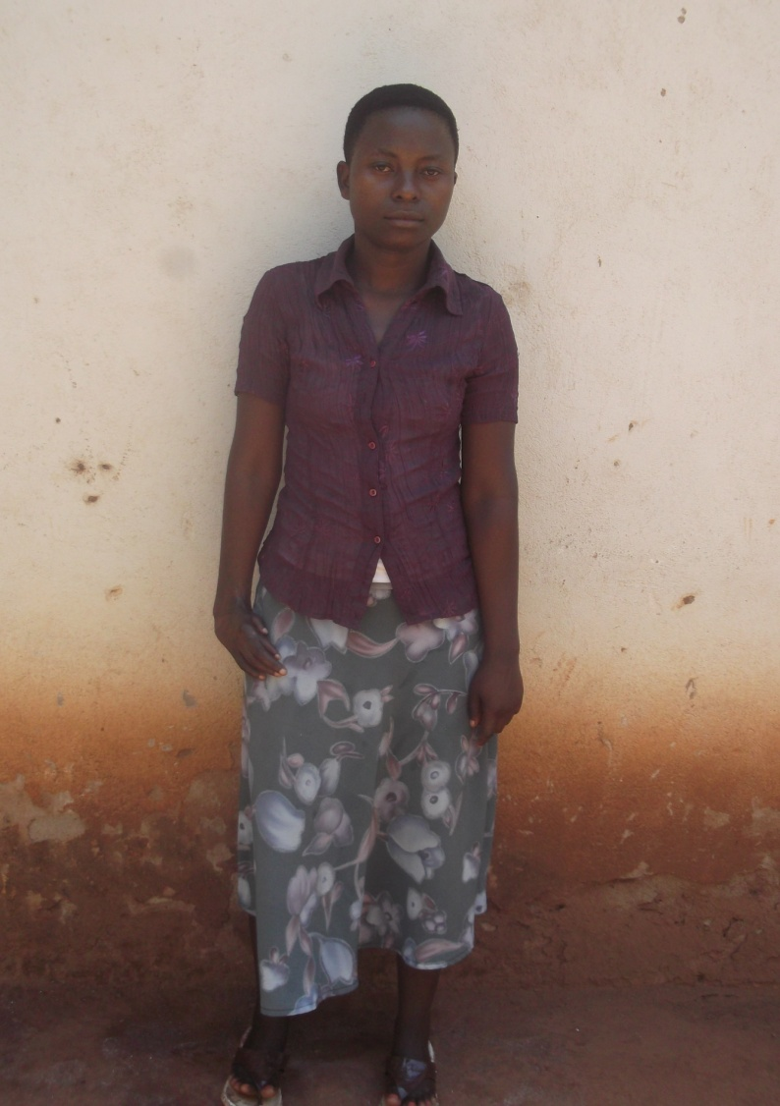
PILI RASHIDI
FOOD PROVIDER AMANI CANTEEN

Slide 8
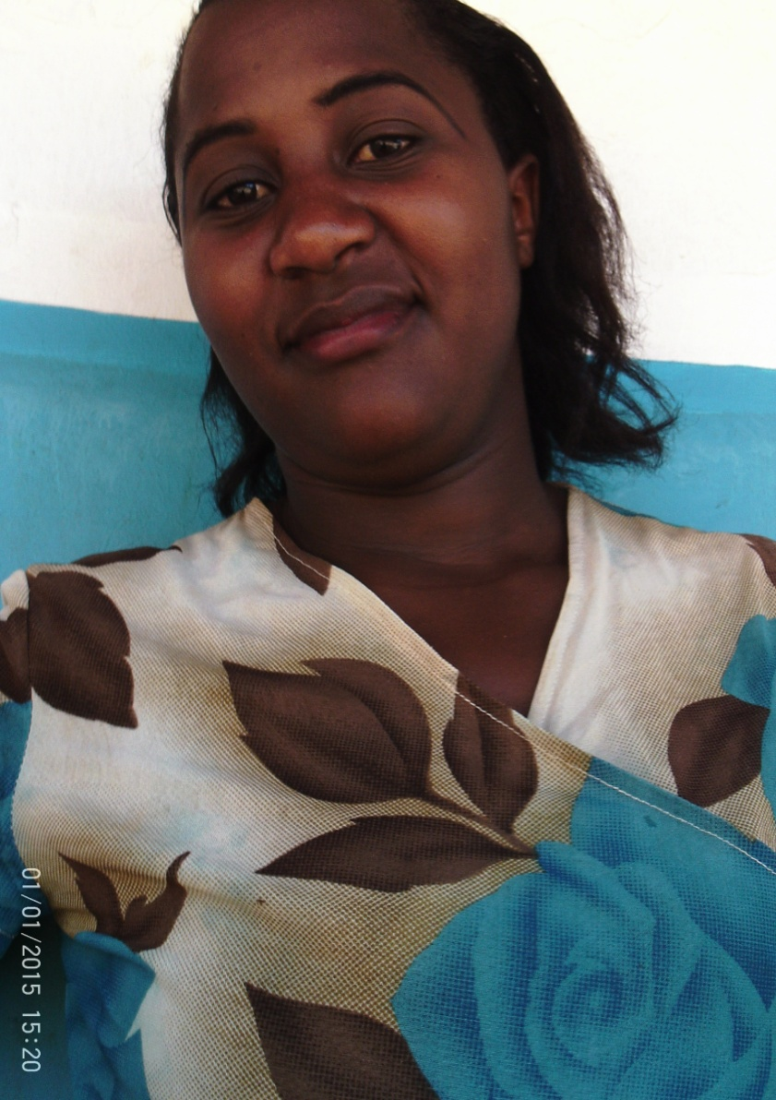
SHANI HASSANI
FOOD PROVIDER AMANI CANTEEN

Slide 9
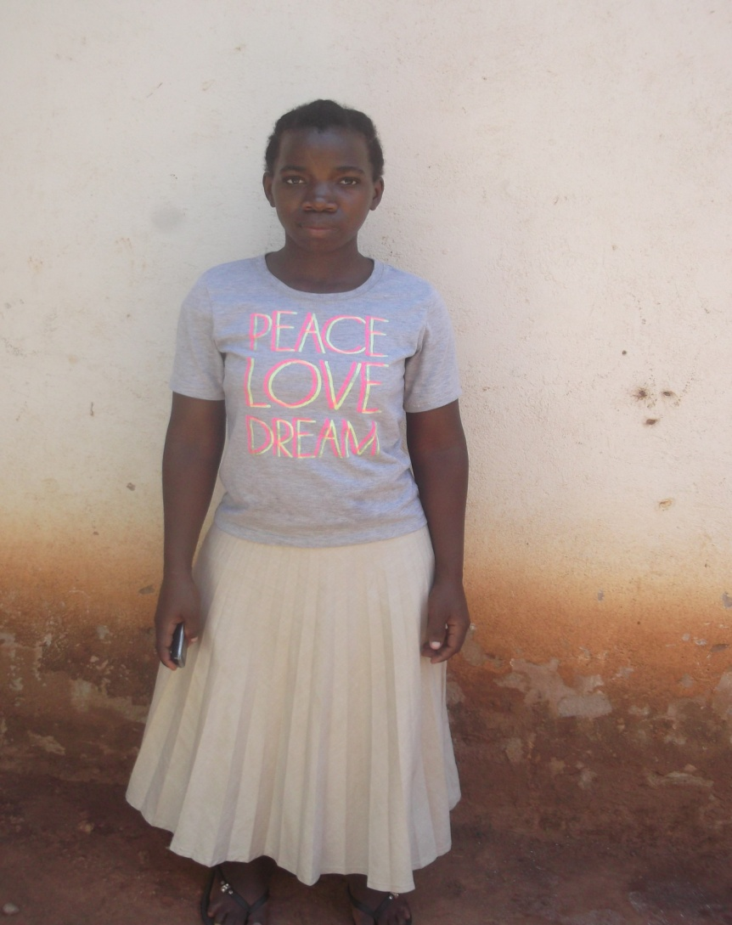
SHANI MOHAMEDI
FOOD PROVIDER AMANI CANTEEN

Slide 10

HALIDA JUMA
HEAD OF AMANI TOURISM DEPARTMENT

Slide 11
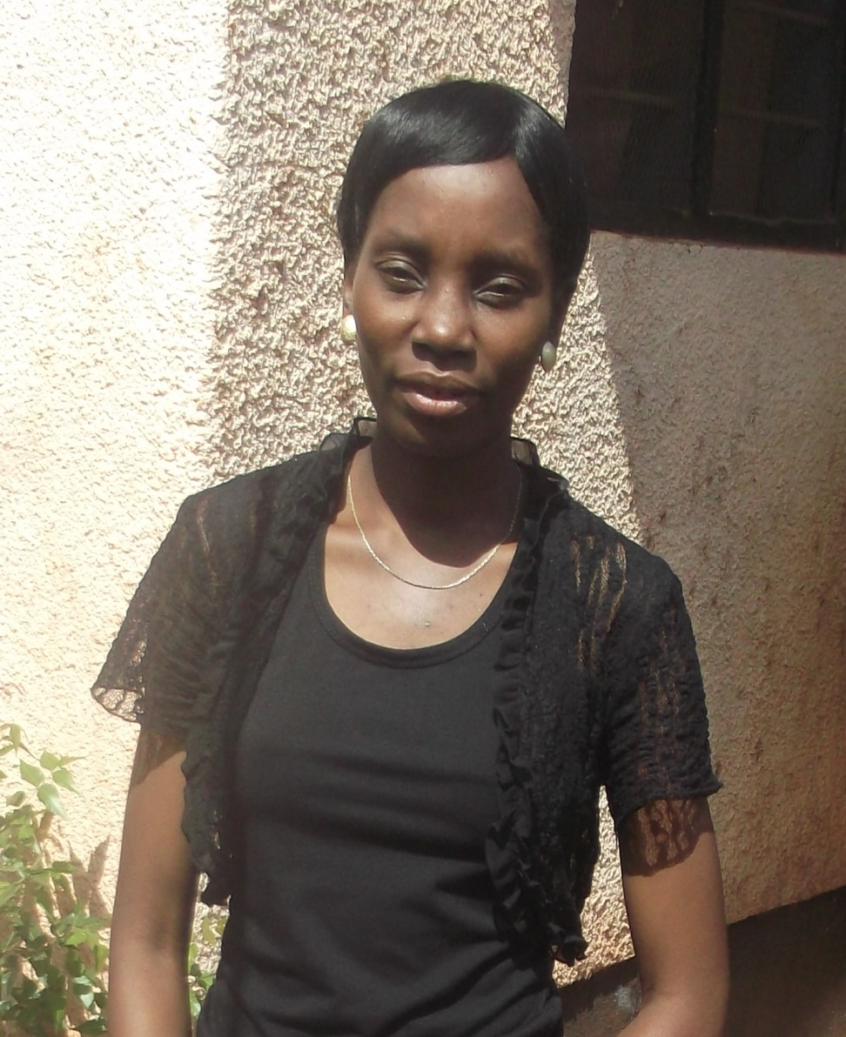
ESTER JOSEPH
AMANI CENTRE CASHIA

Slide 12
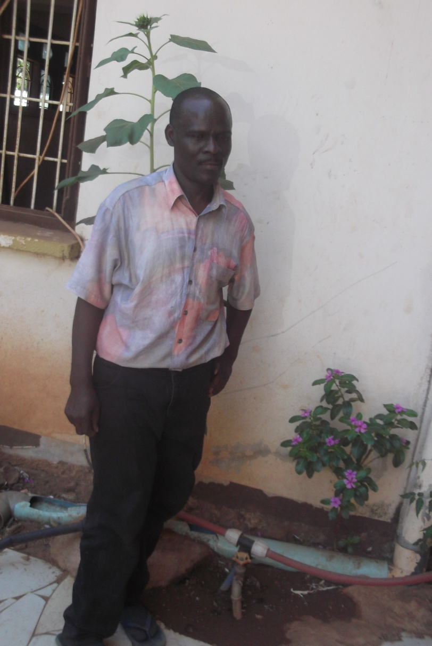
THOBIAS STIVIN
HEAD OF PHYSIOTHERAPY

Slide 13
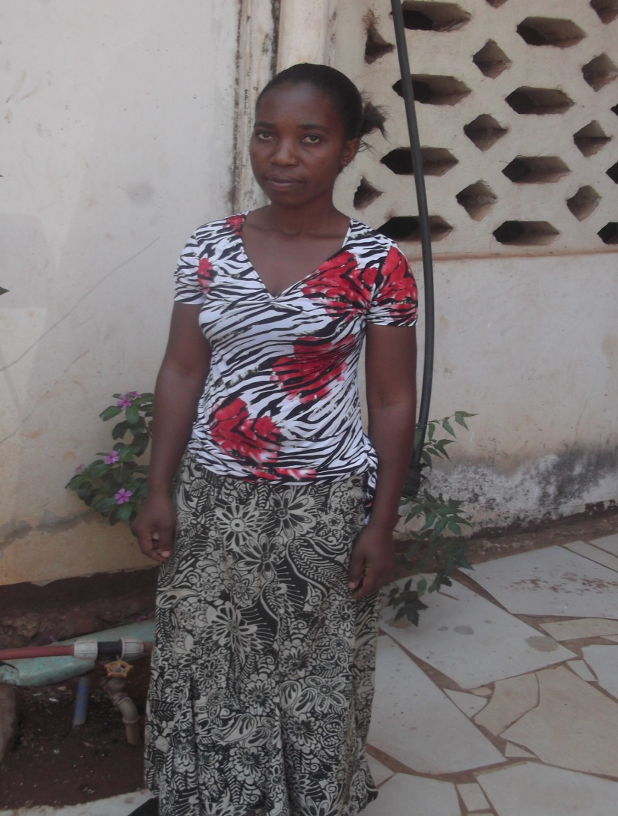
ZENA SELEMANI
NURSE OF AMANI CENTRE

Slide 14
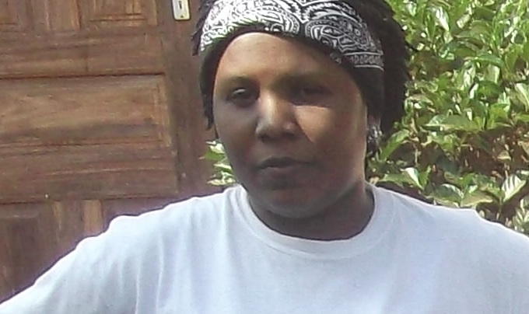
MAGRETH MSELEMU
AMANI NURSARY SCHOOL TEACHER

Slide 15
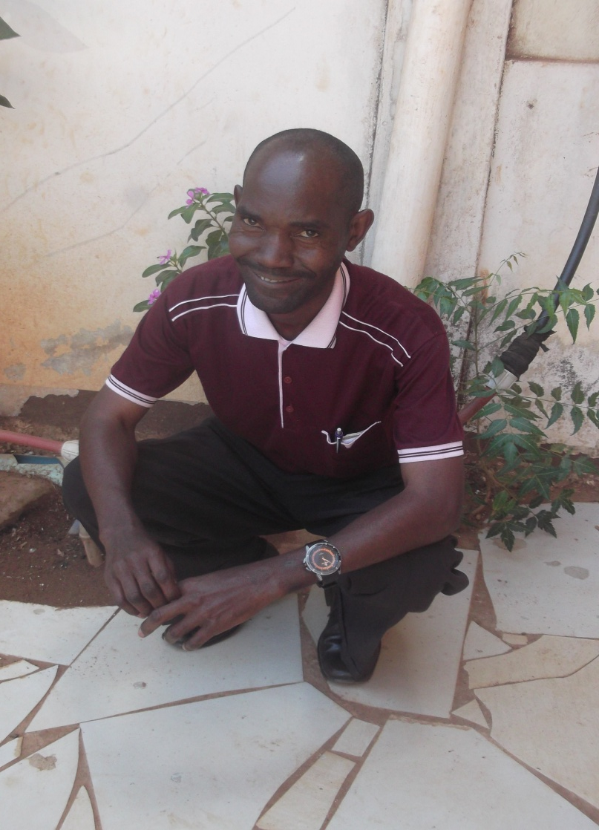
CONRAD ANTONY
HEAD OF EDUCATION DEPARTMENT

Slide 16
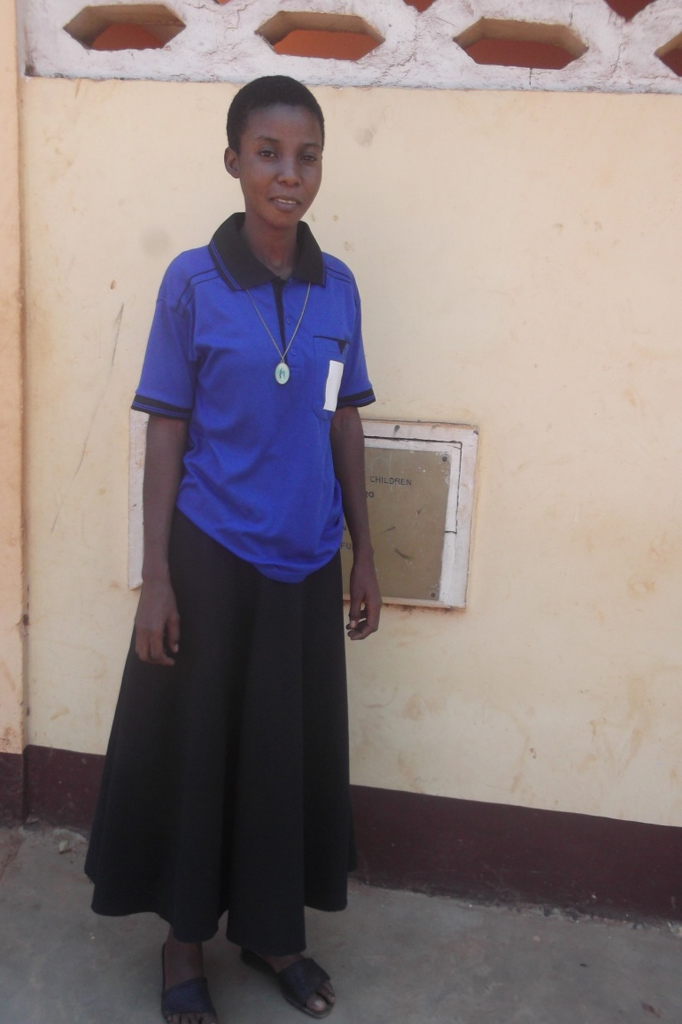
MARTHA KIMALO
MATRON AND STORE KEEPER DEPARTMENT

Slide 17
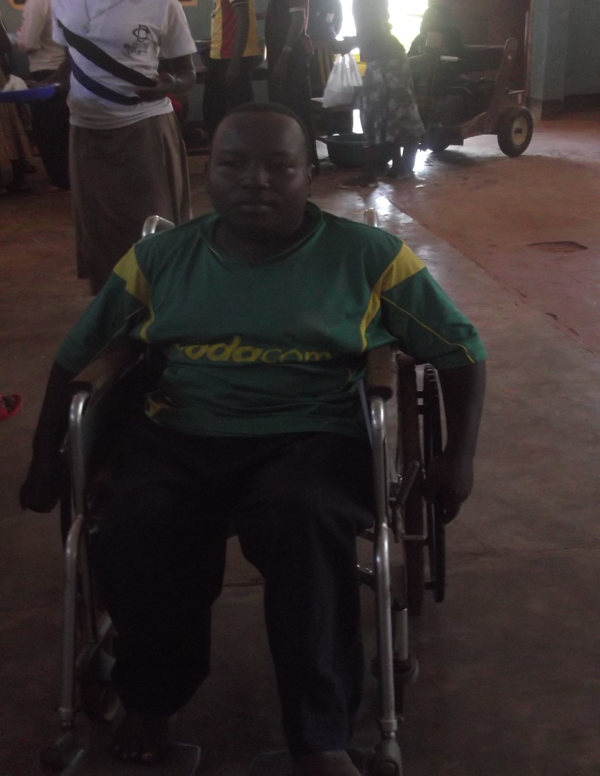
BARAKA ELIAS
SHOES DEPARTMENT

Slide 18
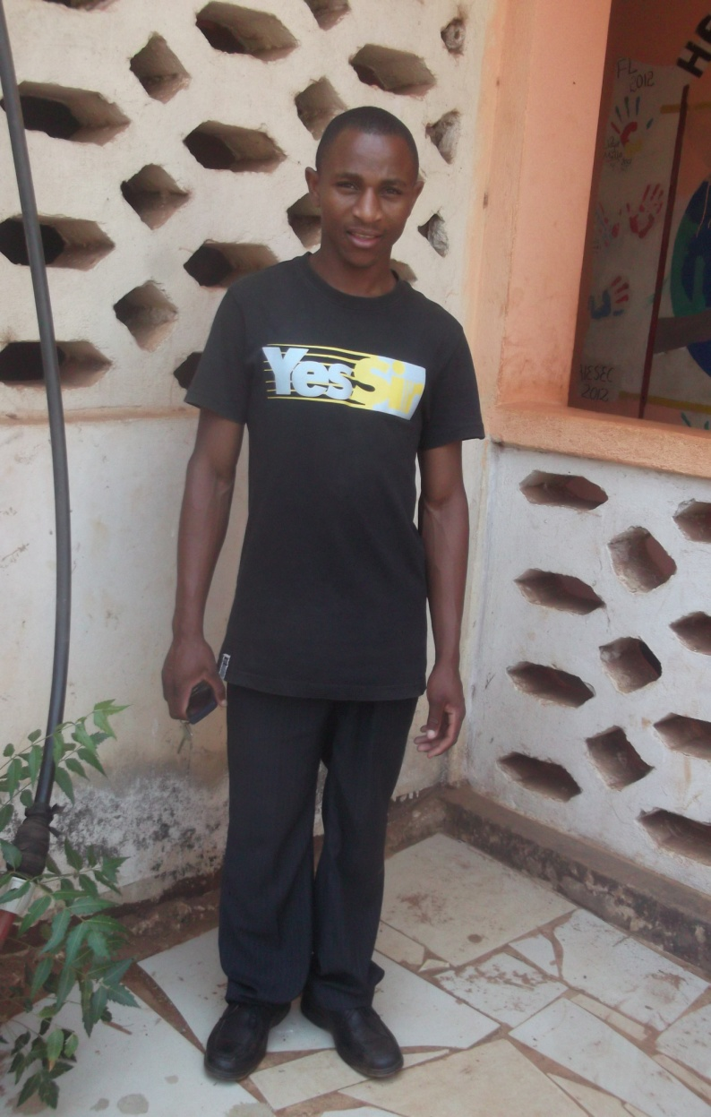
ISDORY POULO
AMANI DRIVER

Slide 19
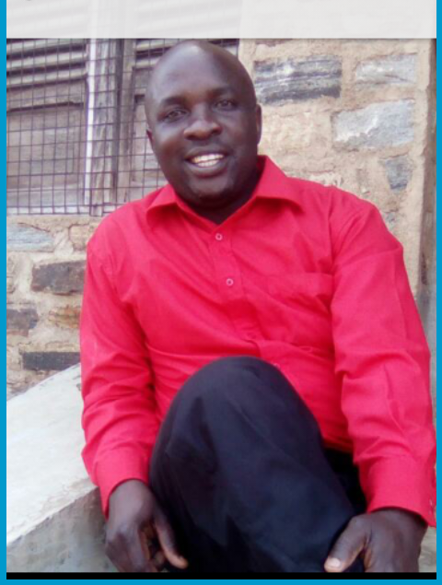
MOSES MWAKATOGWA
HEAD OF AMANI TRANSPORT

Slide 20

THOMAS SENYAGWA
AMANI PRODUCTION MAGER

Slide 21
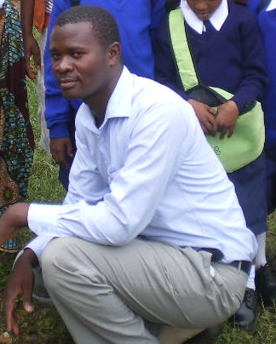
EMMANUEL ELIAS
DEAF TEACHER

Slide 22
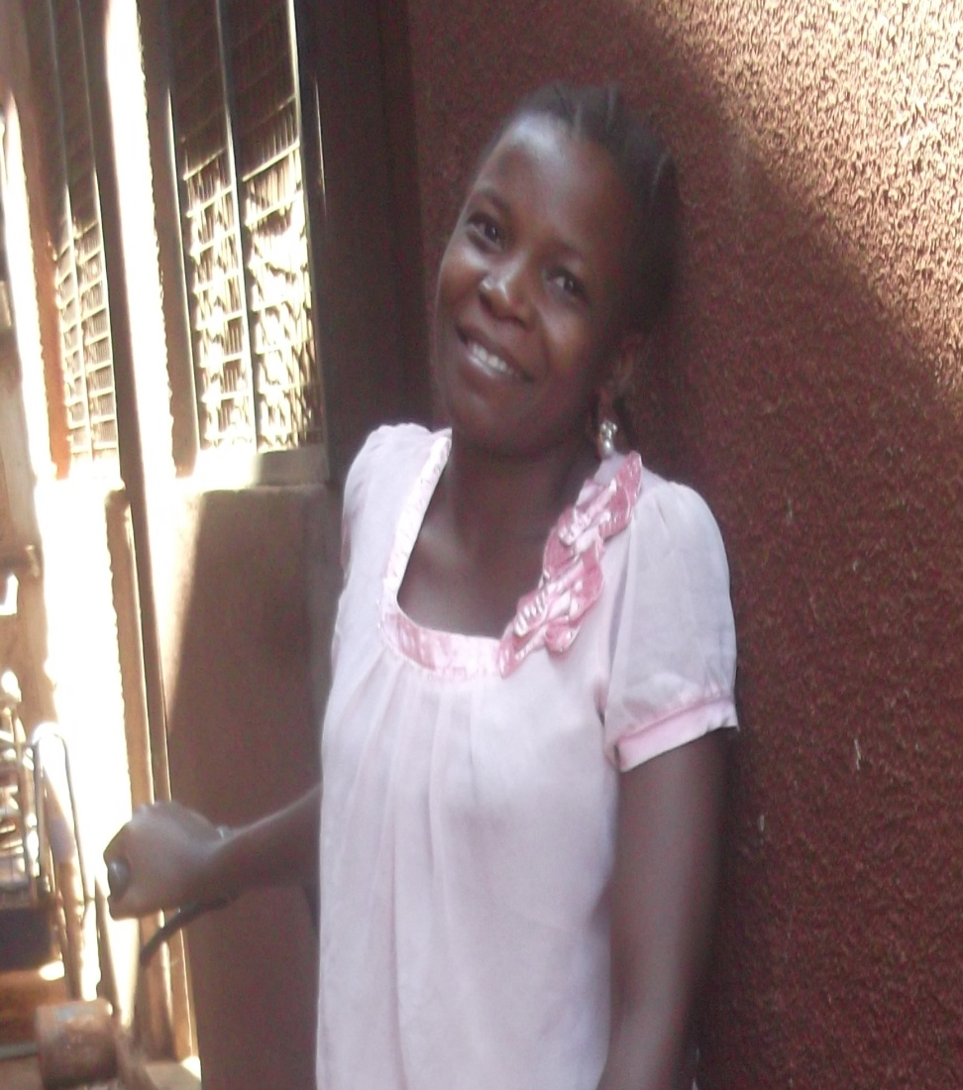
VILETH DAVID
HEAD OF THE KITCHEN DEPARTMENT

Slide 23
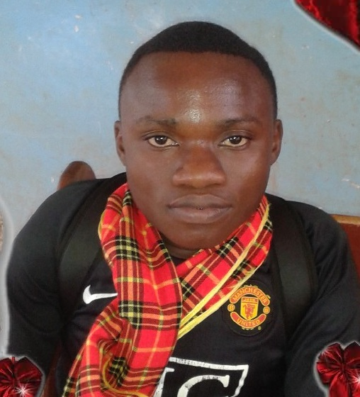
BENEDICTY L. ASTERY
STATIONARY DEPARTMENT

Slide 24
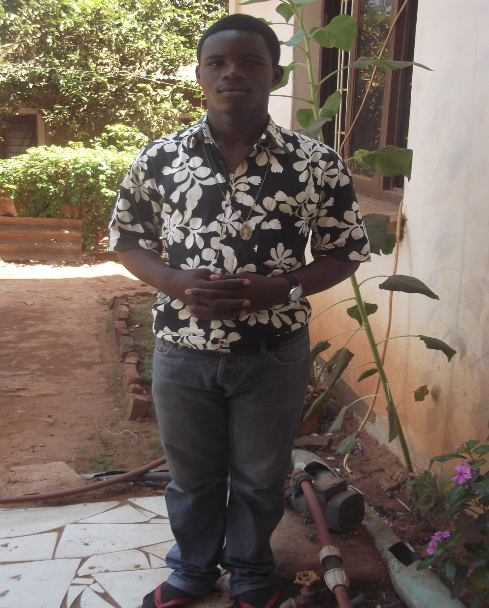
BR. DANIEL DOMINIC
PHYSIOTHERAPHY DEPARTMENT

Slide 25
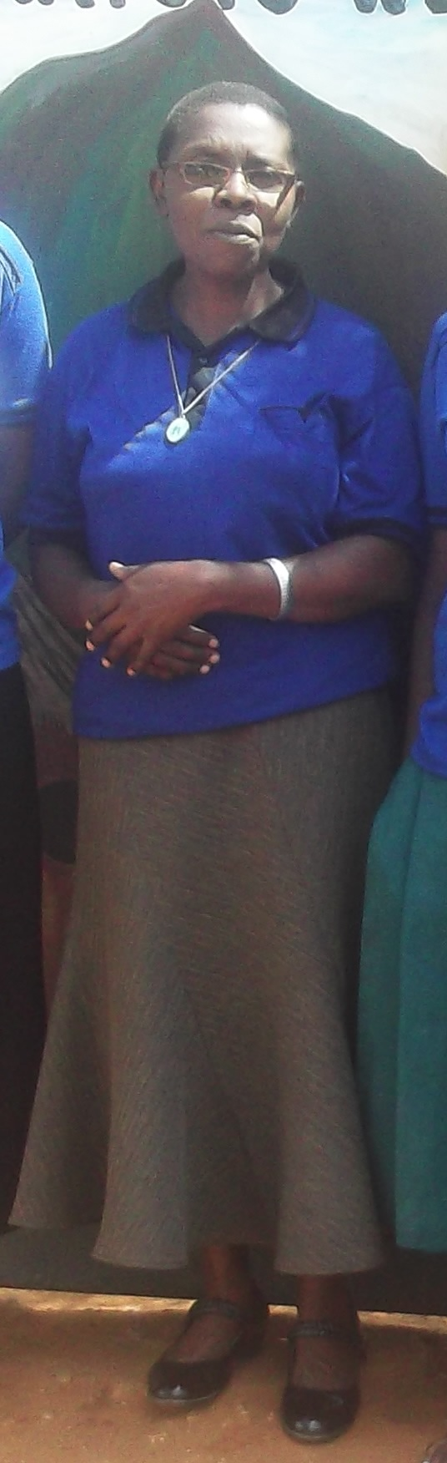
SR. STEPHANIA NYAMBO
TOILER DEPARTMENT

Slide 26
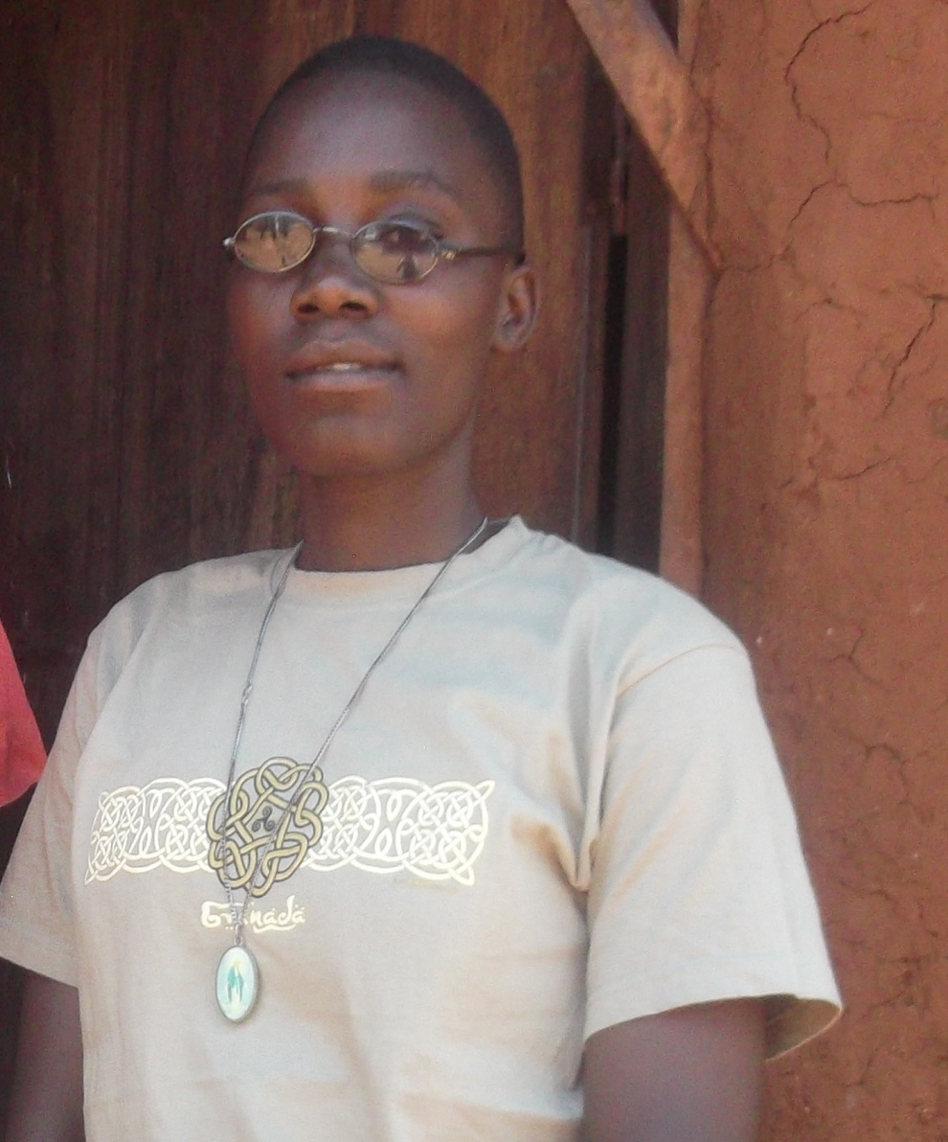
SR. SOPHIA MWITA
PHYSIOTHERAPHY DEPARTMENT

Slide 27
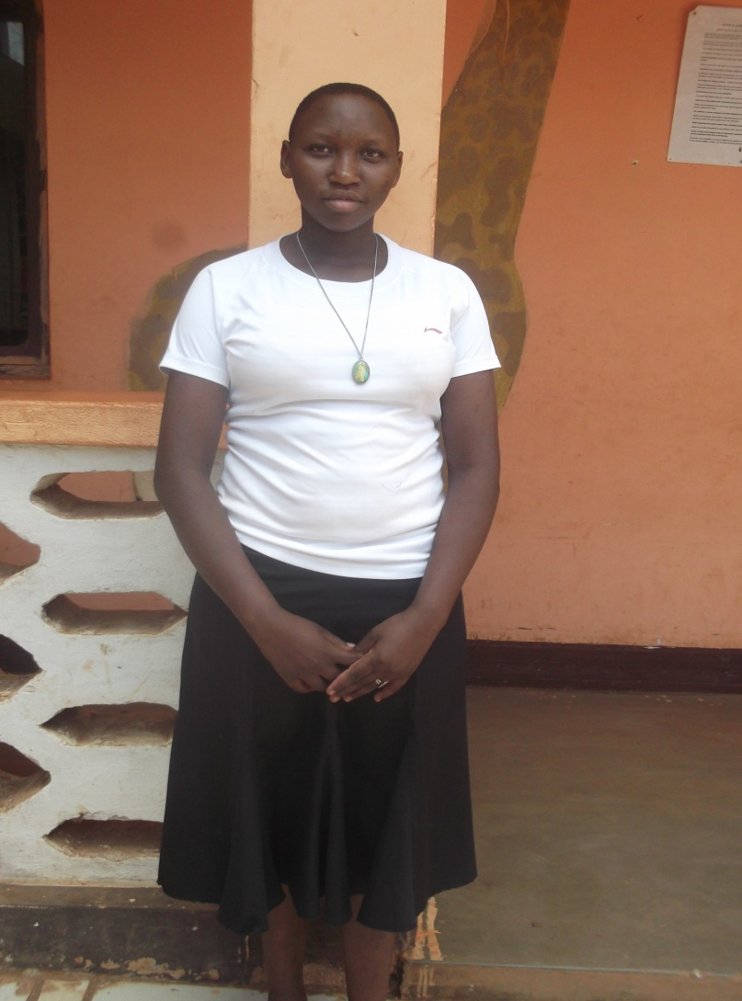
SR. MARIA PETRO
DAYCARE TEACHER

Slide 28
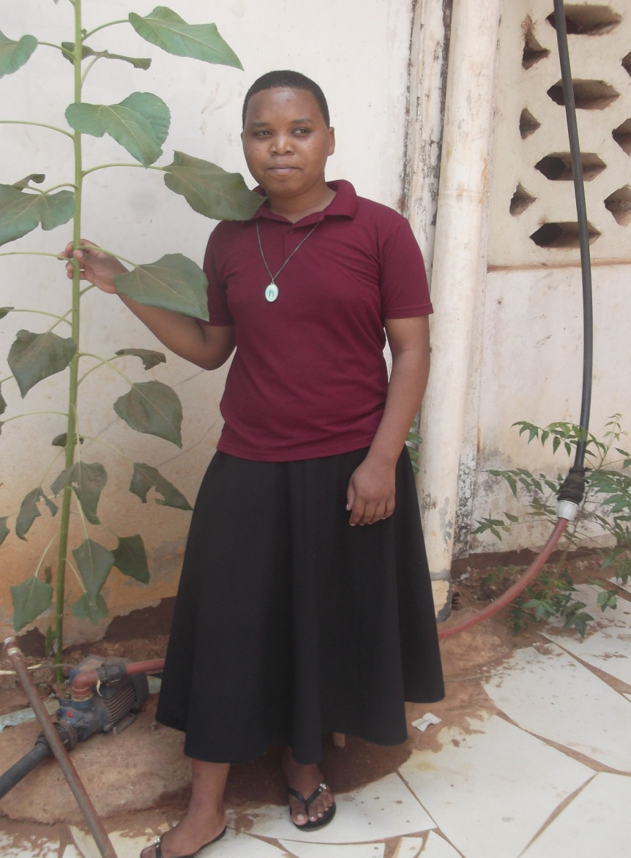
SR. GETRUDA THOMAS
STATIONARY DEPARTMENT

Slide 29
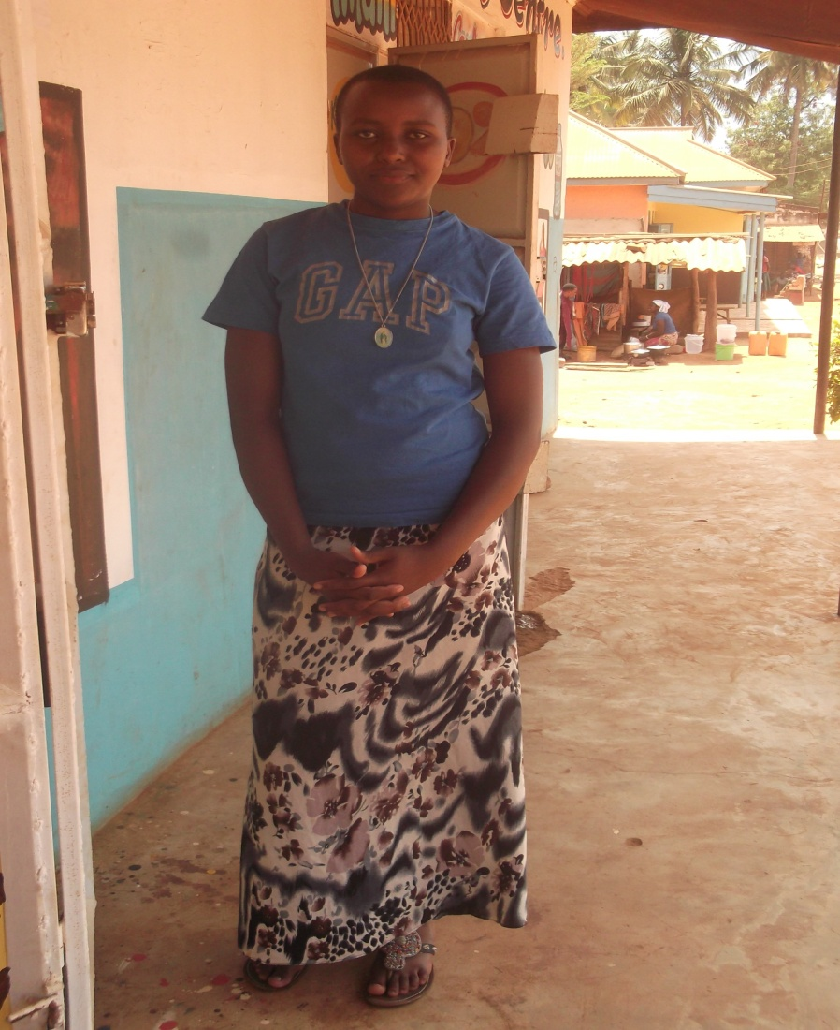
SR. EPIFANIA D. KILATY
STATIONARY DEPARTMENT

Slide 30
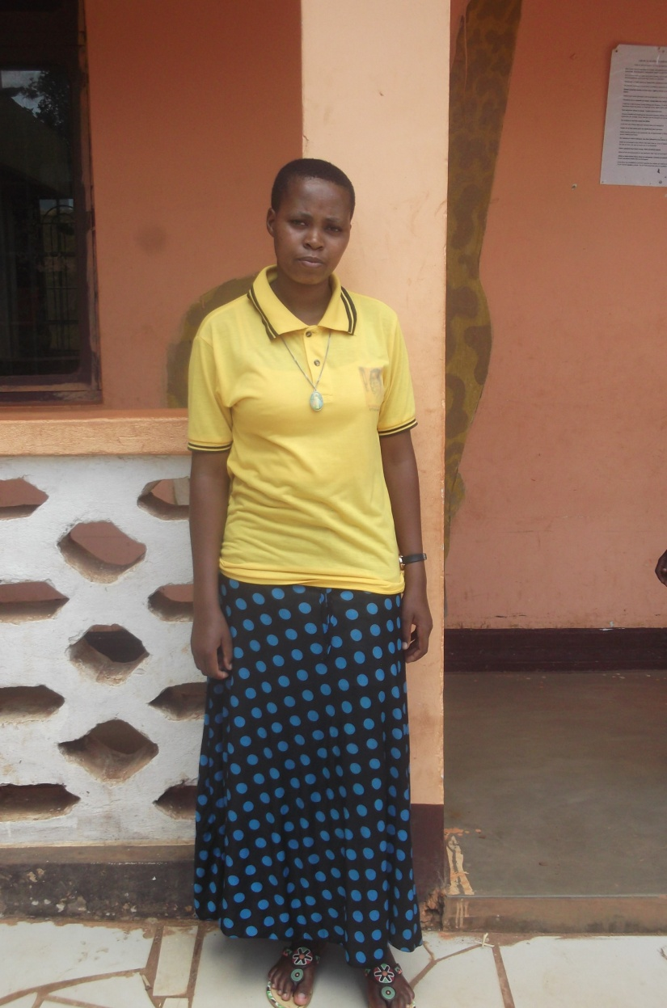
SR. OLIVA SIMEO
DAYCARE TEACHER

Slide 31
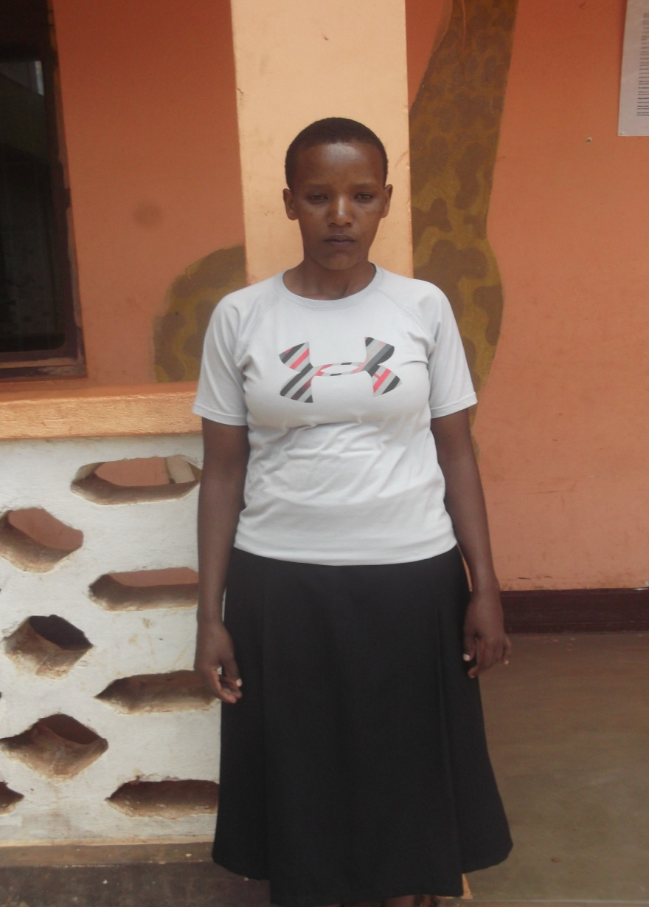
SR. RESTITUTA PETRO
PHISIOTHERAPHY DEPARTMENT

Slide 32
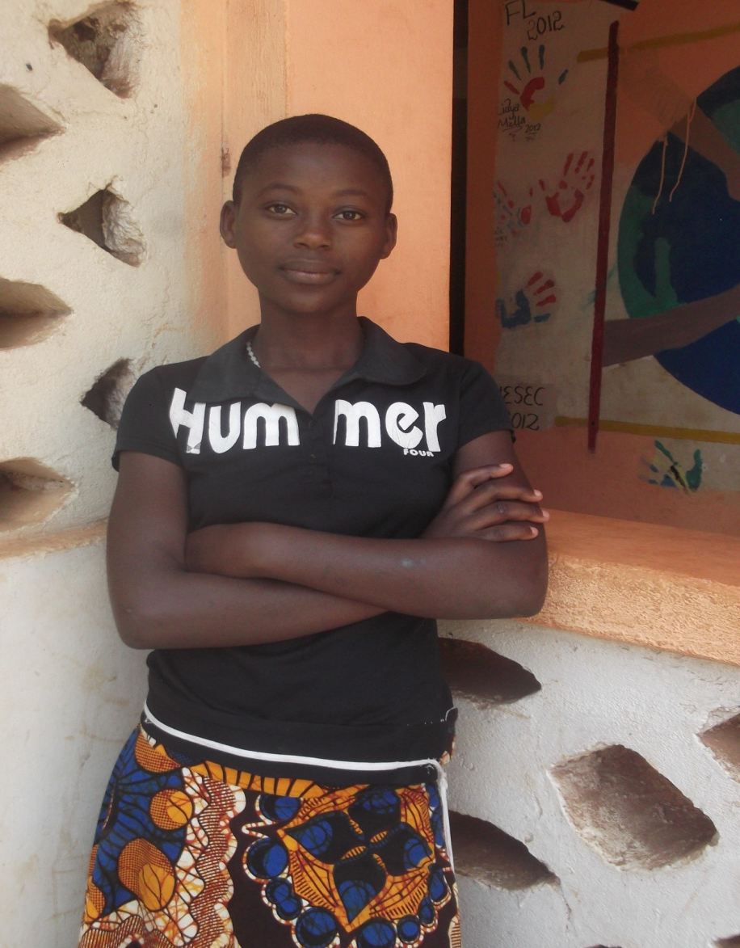
SR. ROSEMARY DANIEL

Slide 33
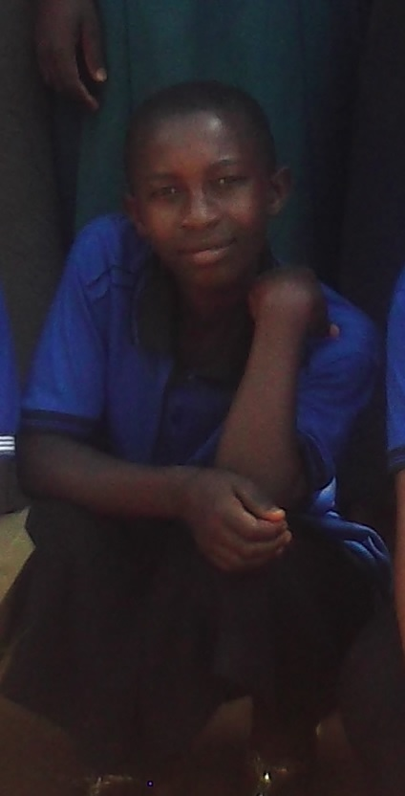
SR. VERONICA VELENCE

Slide 34
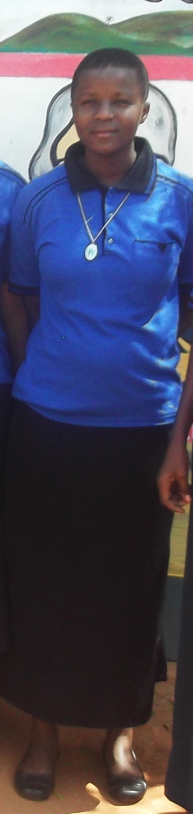
SR. JULIANA RICHARD

